Slide 1
Improving registration of births, stillbirths, and deaths
Bhaskar Mishra
UNICEF

Slide 2
Guidance on Health Sector Contributions to Improving Civil Registration on births and deaths

Slide 3
Missed opportunities: Birth registration lags behind maternal health services and immunization coverage

Slide 4
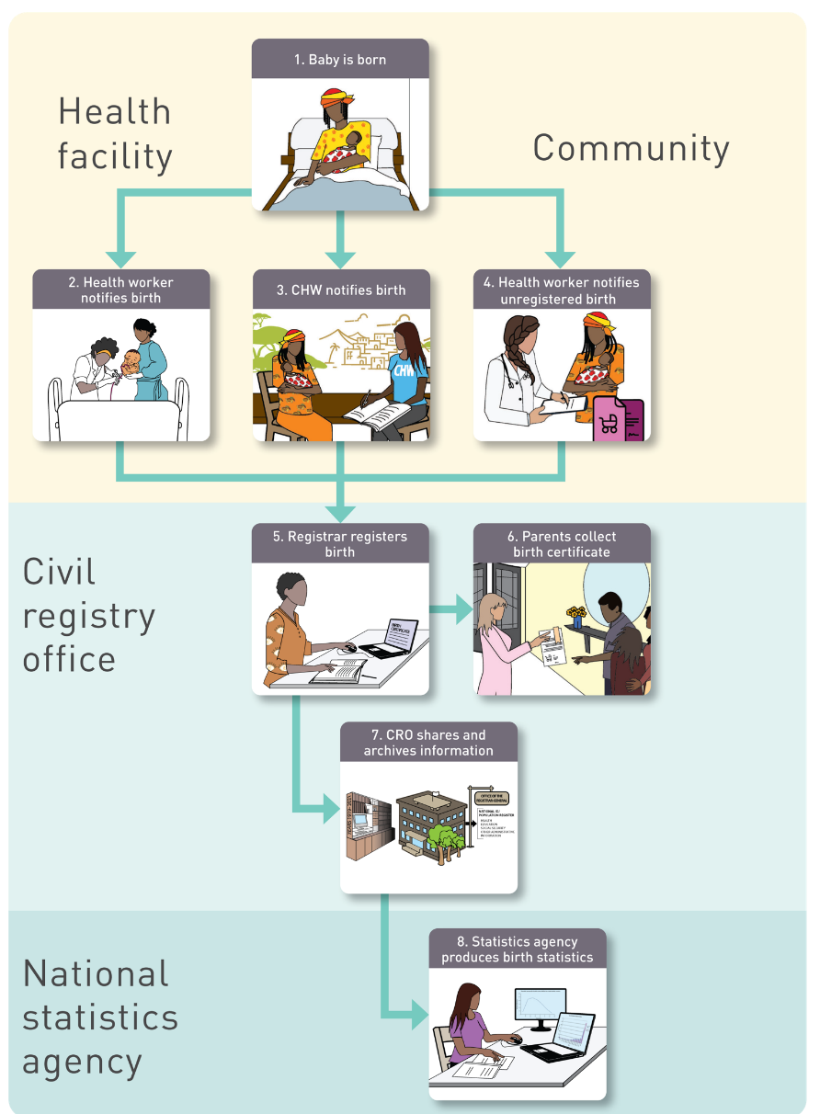
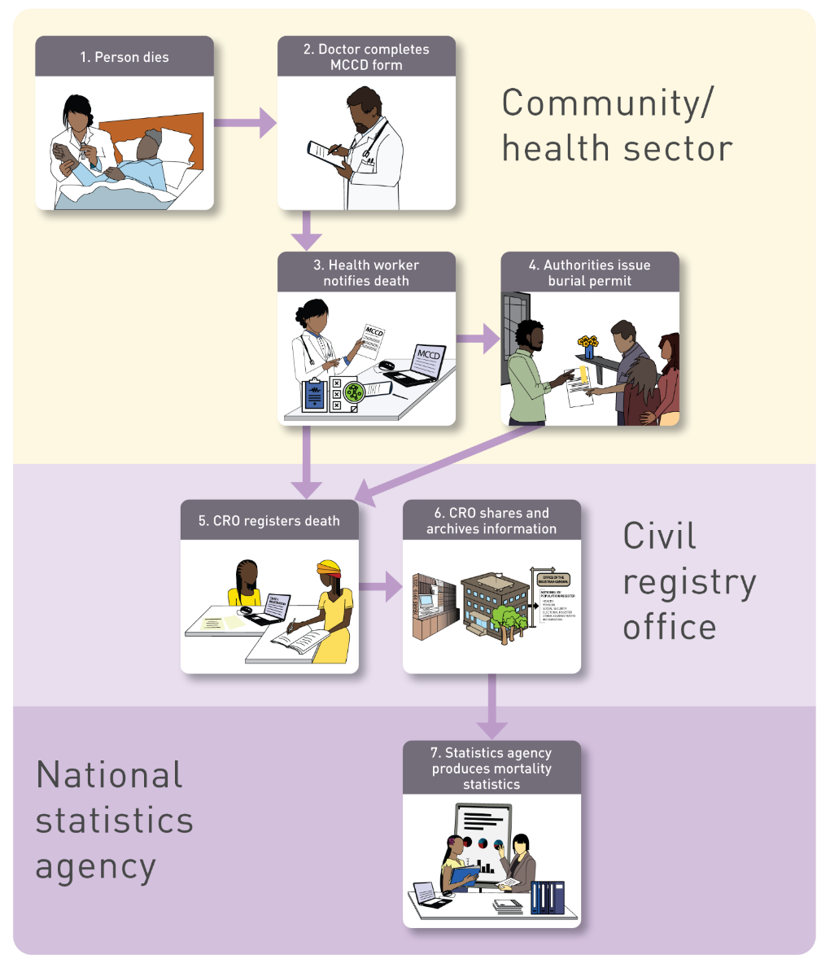
Generic processes for vital events registration
LIVE BIRTH/STILLBIRTH Registration
DEATH Registration

Slide 5
Premises and principles
Births and deaths often take place with the support of health agents.
Health workers are frontline workers reaching out to the population
From passive to active notification of vital events
Shift the burden of notification from families.
Work with health agents for active notification of vital events and improved timeliness and data quality.
Move information, not people
Collect information once and at source.
Use for multiple purposes – for health, civil registration, statistics, population registers, national UID.
Health systems routinely collect data on births, deaths and causes of death.
Release the potential of health systems for CRVS
Notes:
Closing summary
Next please

Slide 6
An addendum to the WHO/UNICEF guidance: Health Sector contribution towards improving the civil registration of births and deaths in low-income countries

Slide 7
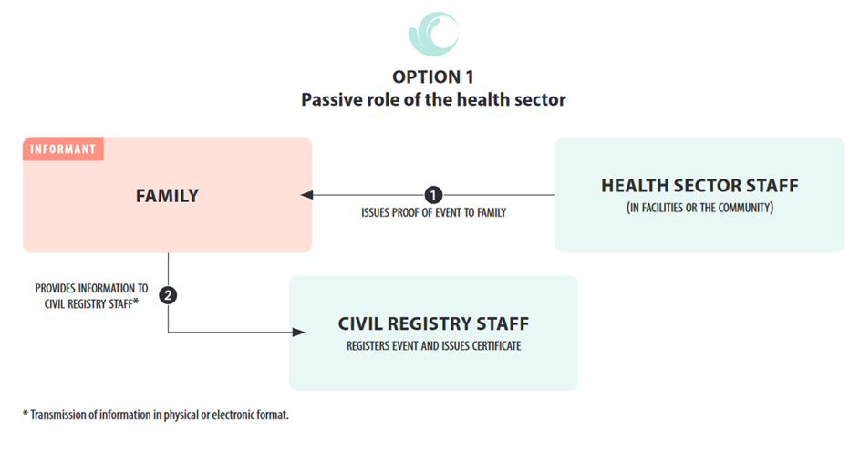
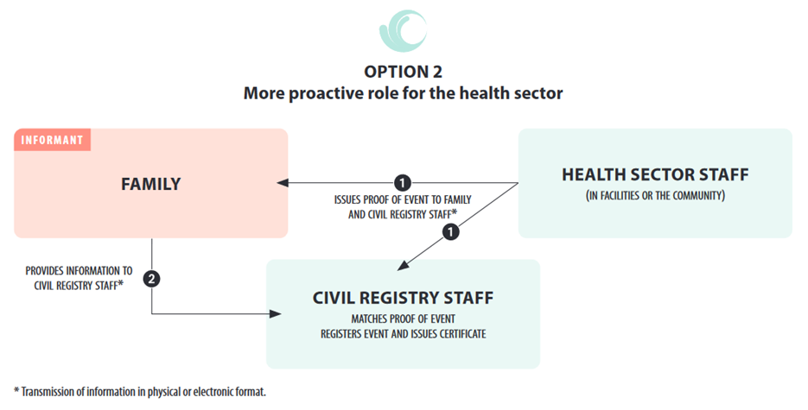
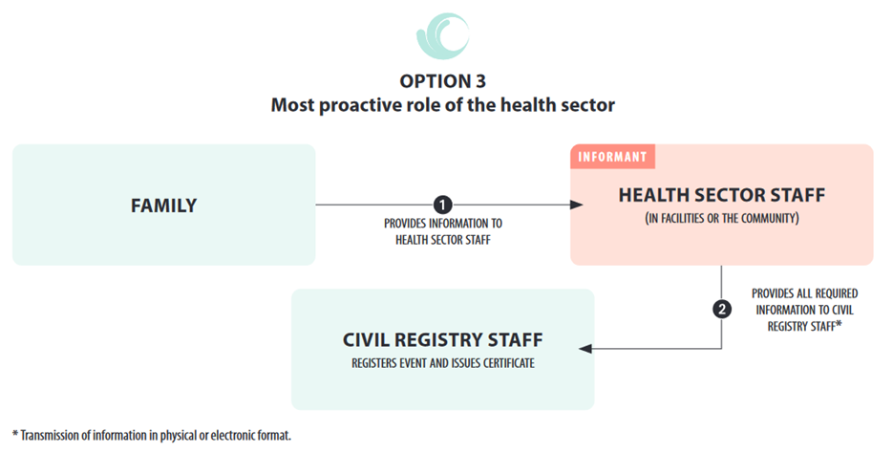
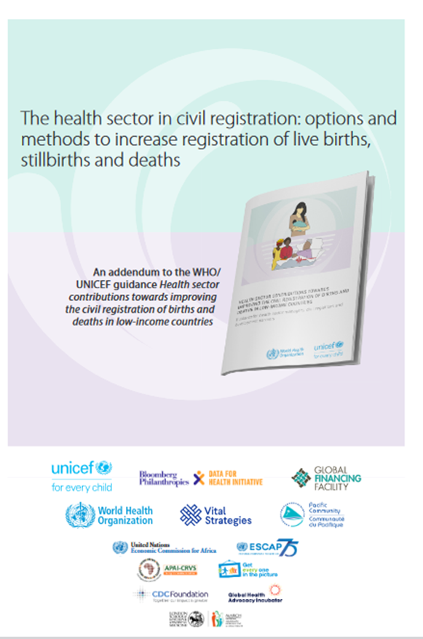
Proactive Role of the Health Sector
Outlines three options for an increasingly active role of the health sector:
Passive role of the health sector
Health as notifier
Health as informant
Provides advantages and disadvantages of the options
Discusses methods for co-location of civil registration at health facilities
https://www.globalfinancingfacility.org/resource/health-sector-civil-registration-options-and-methods-increase-registration-live-births

Slide 9
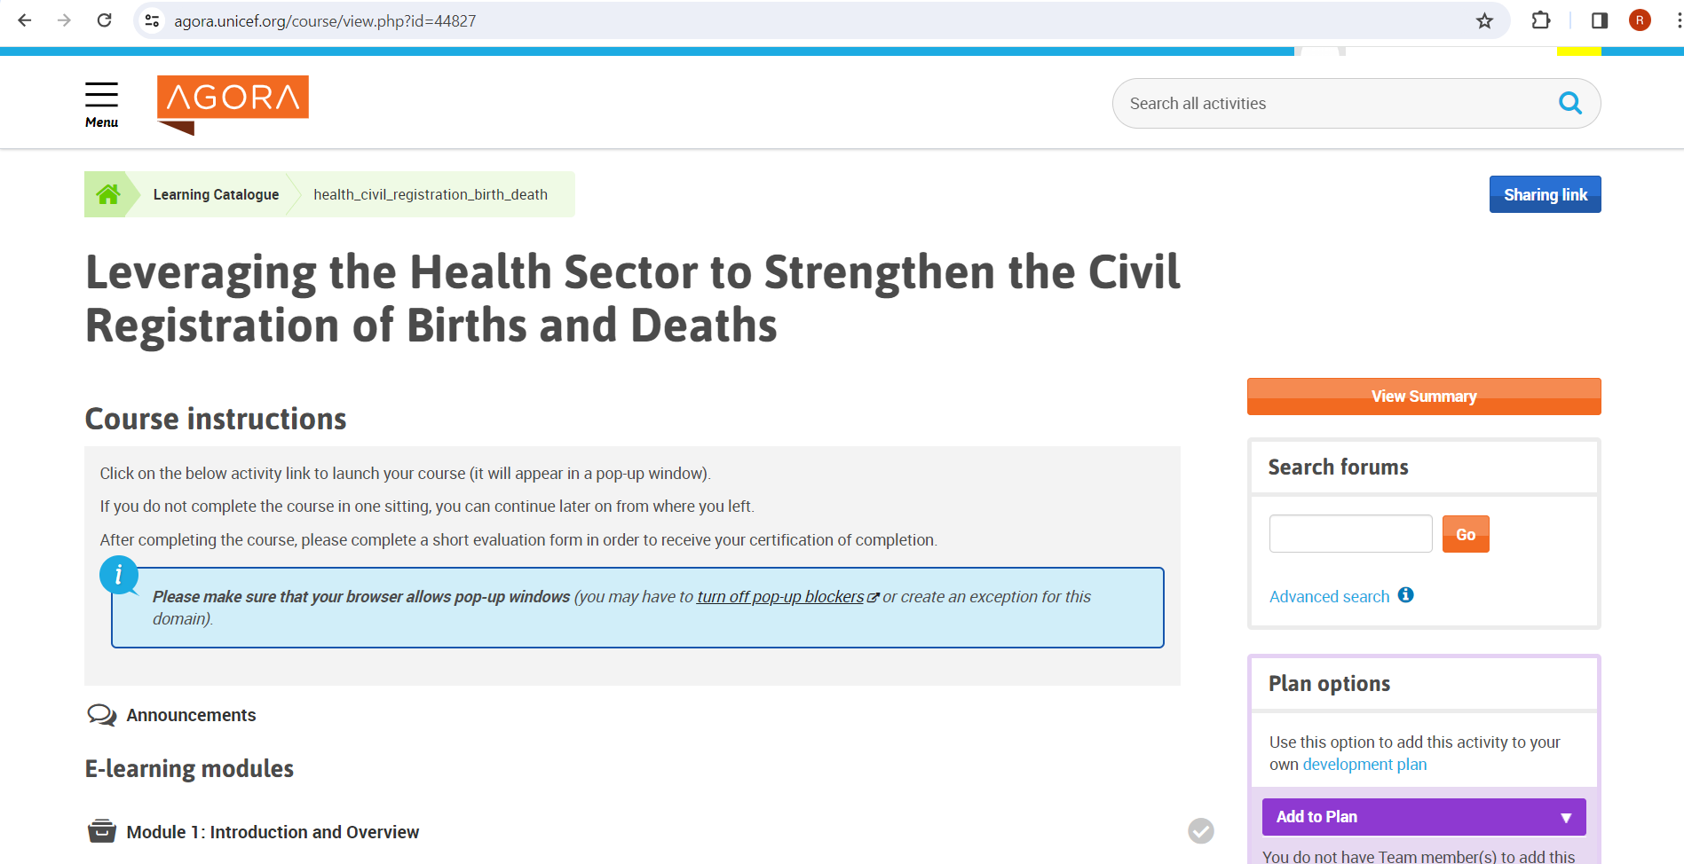

Slide 10
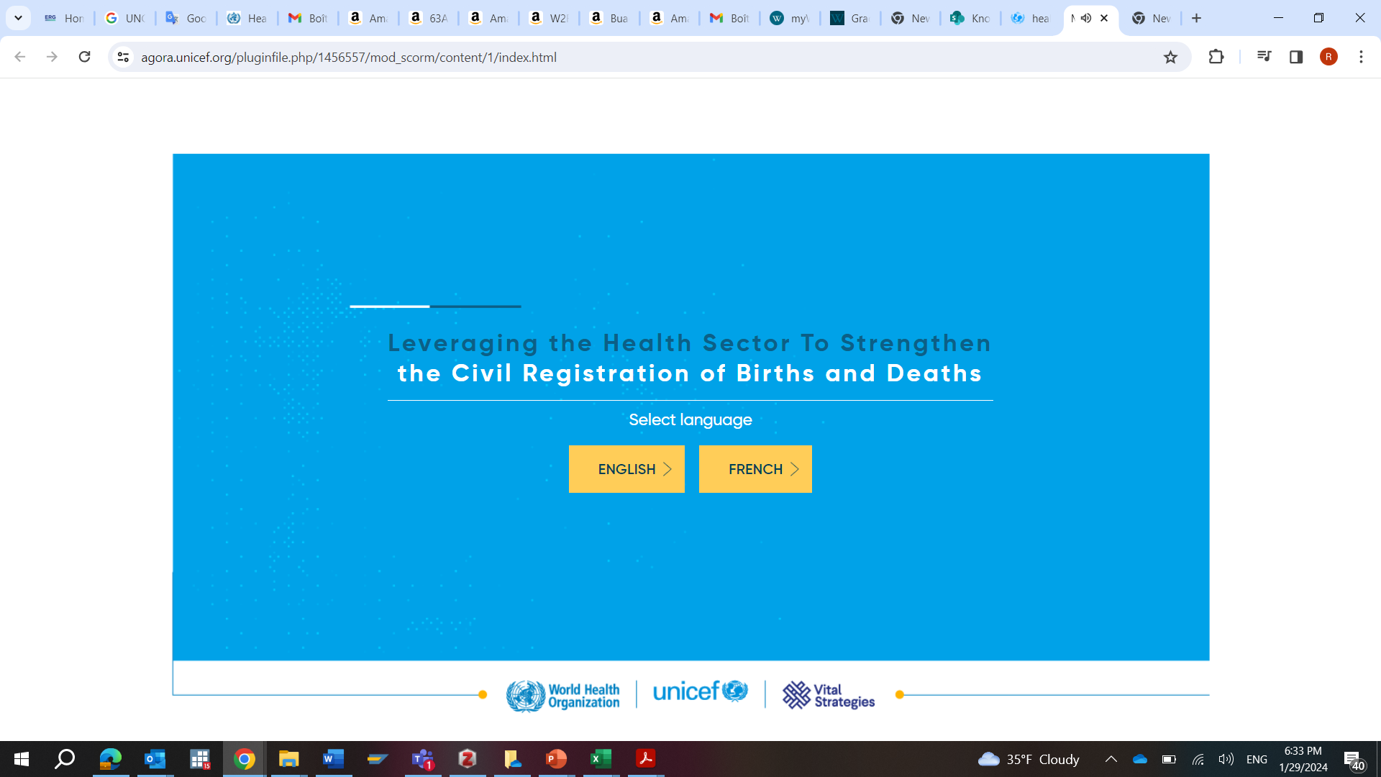

Slide 11
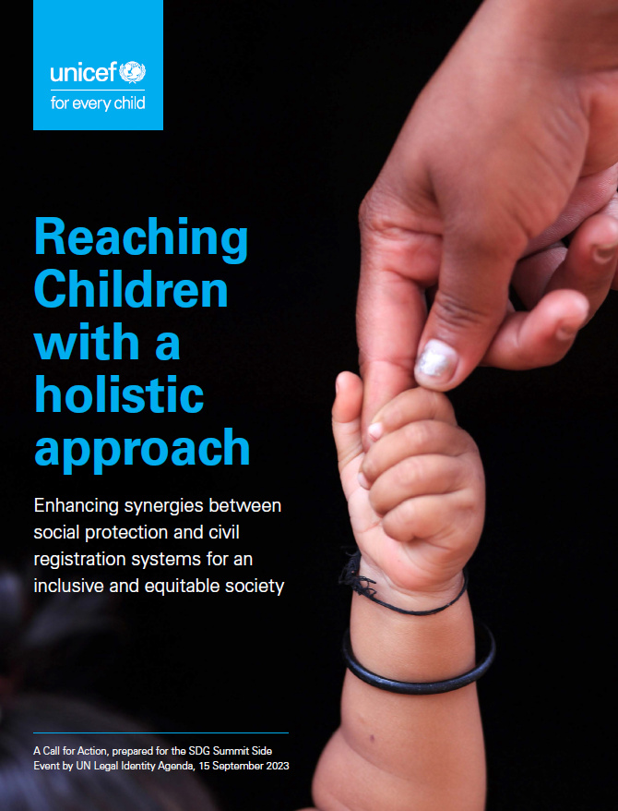

Slide 12
