Slide 1
Improving registration of births, deaths
Hillary Kipruto
WHO

Slide 2
Content of presentation
Some Key consideration for improvement of registration of births and deaths
Technical resources available

Slide 3
Some Key consideration for improvement of registration of births and deaths
Strengthening systems and capacity for:
Governance for CRVS within the overall framework for national health information system
Generation, storage and transmission of data
Analysis of data, including data quality assessments
Communication and use of data

Slide 4
Technical Resources available
WHO civil registration and vital statistics strategic implementation plan 2021-2025
Strategic Objectives for the WHO CRVS Strategic Implementation Plan (2021-2025)
SO1: Strengthen coordination between health sector and other national CRVS stakeholders and international CRVS partners
SO2: Strengthen CRVS cause of death reporting, vital event notification and integration with civil registration
SO2a: Strengthen cause of death reporting and vital event notification in health facilities, and integration with civil registration
SO2b: Strengthen cause of death reporting and vital event notification for deaths in the community and integration with civil registration
SO3: Build capacity to analyse and use mortality and cause of death data for policy purposes
SO4: Improve reporting, production and dissemination of vital statistics including cause of death
Notes:
The WHO CRVS Strategic Implementation Plan 2021-2025 aims to empower Member States to more effectively mobilize their health sector to lead, or contribute to, CRVS system strengthening efforts in order to ensure maximum benefit from routine data systems for policy and development.

Slide 5
Technical Resources available
Improving the quality and use of birth, death and cause-of-death information
an introduction to civil registration and vital statistics systems (Chapter 1);
A roadmap, which outlines the process for reviewing current systems (Chapter 2);
an assessment framework, which provides a structure for the detailed review (Chapter 3).
3 The WHO assessment framework
3.1 Development and structure
3.2 Overview of components and subcomponents of the WHO assessment framework
3.3 Component A – Legal basis and resources for civil registration
3.4 Component B – Registration practices, coverage and completeness
3.5 Component C – Death certification and cause of death
3.6 Component D –ICD mortality coding practices
3.7 Component E – Data access, use and quality checks

Slide 6
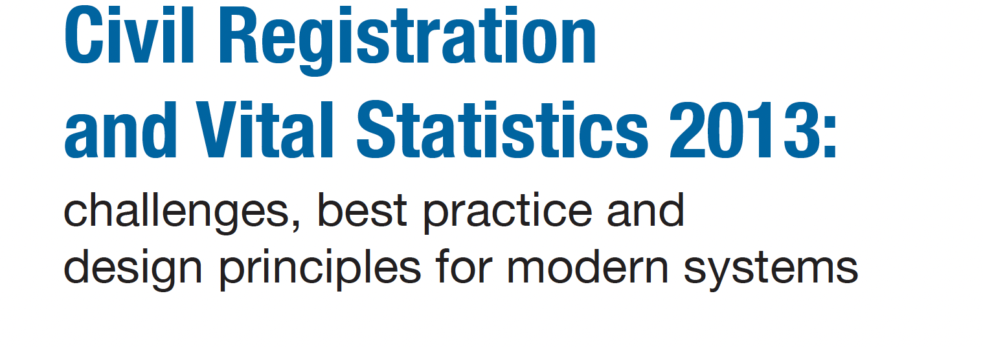
Technical Resources available
Section 1. Civil registration and vital statistics information systems
Section 2. Current status and challenges relating to CRVS IS
Section 3. Best practices of CRVS information systems
Section 4. Challenges and opportunities for CRVS systems
Section 5. Reflections on design principles for modernizing CRVS IS
Civil Registration and vital statistics, challenges and best practices

Slide 7
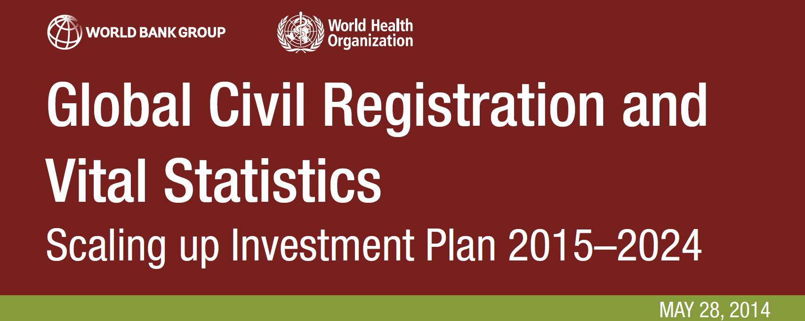
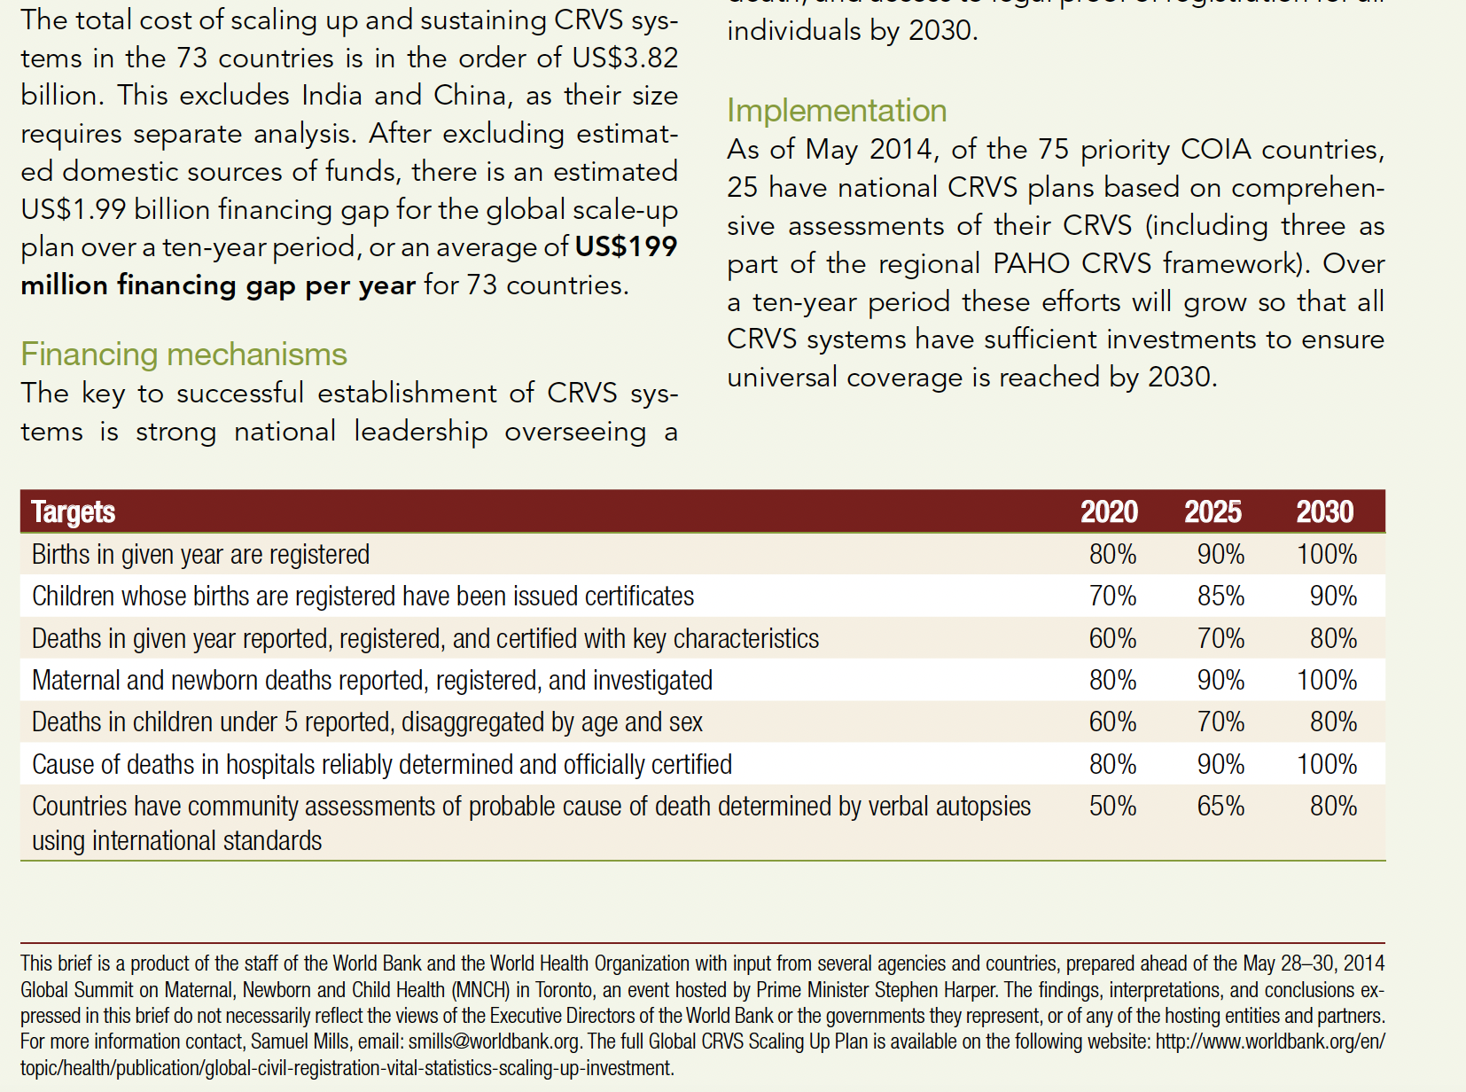
Technical Resources available
Global Civil Registration and Vital Statistics Scaling up Investment Plan 2015–2024
Why does CRVS matter?
Current state of CRVS
Why are CRVS systems in such poor state?
What progress has been made to strengthen CRVS systems?
The opportunity to transform CRVS
The Scaling Up Plan

Slide 8
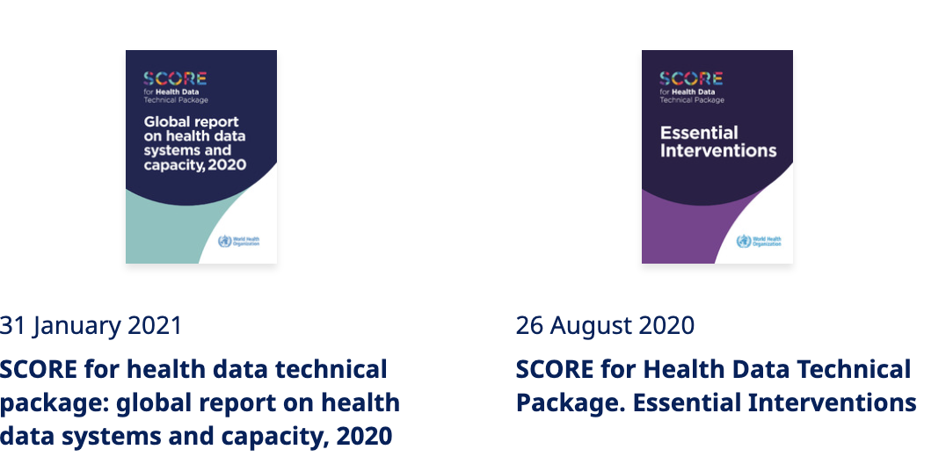
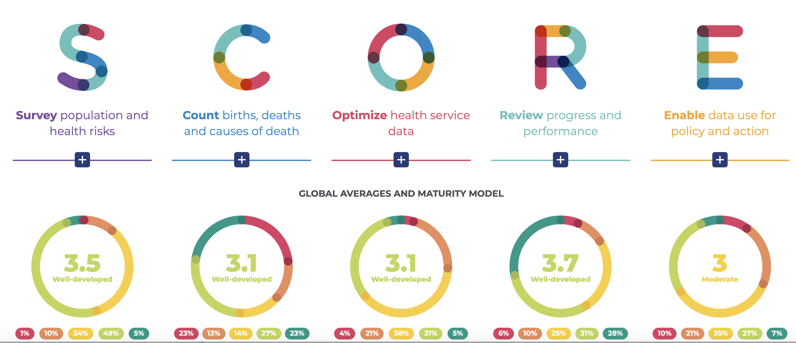
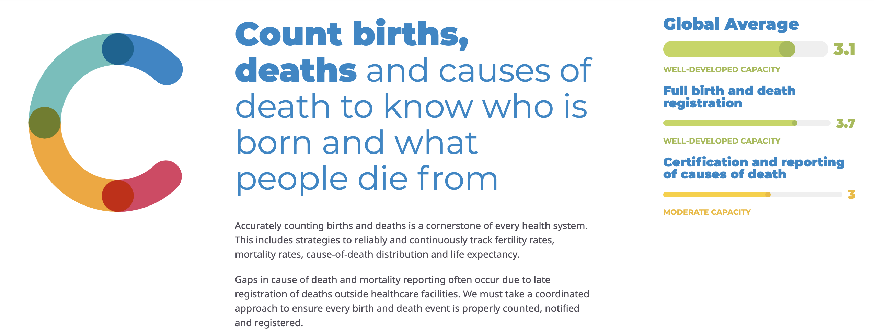
Technical Resources available
SCORE Tools C - World Health Organization (WHO)
The SCORE for Health Data Technical Package was developed by WHO and partners to assist Member States in strengthening country data systems and capacity to monitor progress towards the health-related SDGs, Triple Billion targets, and other national and subnational health priorities.

Slide 9
Technical Resources available
SCORE Tools C - World Health Organization (WHO)
Verbal autopsy standards: ascertaining and attributing causes of death tool
WHO civil registration and vital statistics strategic implementation plan 2021-2025
WHO AFRO Regional Training on Medical Certification and Cause of death

Slide 10
Technical Resources available
Verbal autopsy standards: ascertaining and attributing causes of death tool
WHO AFRO Regional Training on Medical Certification and Cause of death

Slide 11
Technical Resources available
Verbal autopsy standards: ascertaining and attributing causes of death tool
WHO AFRO Regional Training on Medical Certification and Cause of death
WHO AFRO Regional Framework for the acceleration of registration of deaths and cause of death information

