Slide 1
Marriage and Divorce Registration: Existing Technical Resources
Violet Kinuthia
Center of Excellence on CRVS
Population and Development Branch, UNFPA HQ

Slide 2
Marriage and Divorce Definitions
Marriage – the act, ceremony or process by which the legal relationship of spouses is constituted (UN, 2014).
Divorce – the final legal dissolution of a marriage which confers on the parties the right to remarriage (UN, 2014).
The legality of marriage may be established by civil, religious or other means as recognized by the laws of each country.
Vital event records and certificates are used as legal documents to protect individuals’ human and civil rights and for accessing basic social services.
Notes:
What is the current knowledge on levels of marriage and divorce registration?
Because many developing countries do not prioritize marriage and divorce registration, it is impossible to use direct measures to estimate completeness levels of marriage and divorce registration. Instead, the best bet is to use indirect means using questions about the registration of marriages and divorces in censuses or surveys.
In the slides that follow, we present to you an analysis of such data for a few countries that collected marriage registration data in the 2010 round of censuses

Slide 3
Marriage and Divorce Definitions
Across the African Continent there is much heterogeneity in "what is a marriage?"
The actual social practices encapsulate traditional religious and customary marriages (in addition to civil marriages) even though many CR systems only record civil marriages.
This makes marriage and divorce registration more challenging than the registration of vital events that are biological processes (eg birth and death)
Marriages can be experienced zero, once or multiple times across the life course, whereas birth and death are only experienced once by everyone.
Notes:
What is the current knowledge on levels of marriage and divorce registration?
Because many developing countries do not prioritize marriage and divorce registration, it is impossible to use direct measures to estimate completeness levels of marriage and divorce registration. Instead, the best bet is to use indirect means using questions about the registration of marriages and divorces in censuses or surveys.
In the slides that follow, we present to you an analysis of such data for a few countries that collected marriage registration data in the 2010 round of censuses

Slide 4
Marriage and Divorce Status/Country Use Cases and Outcomes
Marriage and divorce registration and certification are important facilitators of gender equality and the SDGs through the protection of rights of women and children.
Many developing countries do not prioritize marriage and divorce registration.
Some countries are analyzing the data and producing tables incorporated into vital statistics reports (Seychelles) while others like SA produce dedicated statistical release and more recently, studies on customary marriages.
Completeness levels of marriage and divorce registration are currently established, in some countries, using adds-on questions on registration status of marriages and divorces in censuses or other surveys.
However, unlike, birth and death registration, there is no continental data on the completeness of marriage and divorce registration.

Slide 5
Marriage and Divorce Registration Resources
There is currently no global or regional guidelines specifically on marriage and divorce registration.
The events are covered under the Principles and Recommendations for a Vital Statistics System (UN Rev. 3 of 2014)
SDG targets 16.9 and 17.19 (b) provides the guideline and target for achievement of legal identity for all in a life course. Missing target for marriages and divorces
Regional: COM5 ministerial commitments to support marriage and divorce registration
UNFPA has developed the “Technical Report on Marriage, Divorce Registration, and Vital Statistics: Where are we? And Where do we go from here?
Notes:
Figure 1 shows large country differences in marriage registration (as low as 52% in Cuba to as high as 96% in Armenia); and in this Figure we show within countries differences, with large differences by geographical region, especially in countries where national averages are very low.
Yet marriage registration is oft-neglected. In the 2010 census round only 6 countries assessed the completeness of marriage registration. What we see here is notable variation in the completeness of marriage registration both between and within countries. The vertical dotted lines here depict the overall national average of marriages that are officially registered. For example, in Armenia + Kyrgyzstan marriage registration is above 92% complete. Whereas in brazil it is on average 60% complete. Whereas in brazil marriage registration across the subnational regions of the country varies from 30% to 74% - as shown by the purple dots.
Why are some marriages registered and others not?

Slide 6
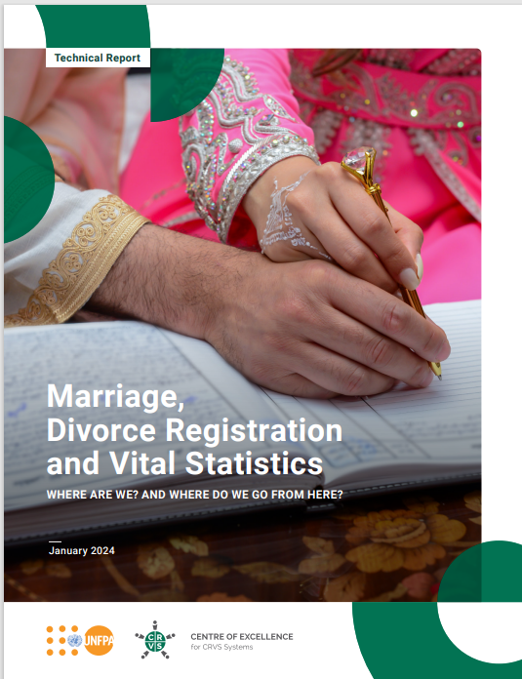
Marriage and Divorce Registration Resources
Name of the implementation guideline: no guideline, only report
“Technical Report on Marriage, Divorce Registration, and Vital Statistics: Where are we? And Where do we go from here?”
Notes:
Figure 1 shows large country differences in marriage registration (as low as 52% in Cuba to as high as 96% in Armenia); and in this Figure we show within countries differences, with large differences by geographical region, especially in countries where national averages are very low.
Yet marriage registration is oft-neglected. In the 2010 census round only 6 countries assessed the completeness of marriage registration. What we see here is notable variation in the completeness of marriage registration both between and within countries. The vertical dotted lines here depict the overall national average of marriages that are officially registered. For example, in Armenia + Kyrgyzstan marriage registration is above 92% complete. Whereas in brazil it is on average 60% complete. Whereas in brazil marriage registration across the subnational regions of the country varies from 30% to 74% - as shown by the purple dots.
Why are some marriages registered and others not?

Slide 7
Marriage and Divorce Registration Resources
Objective and purpose of the resource & key topics
Highlights the importance of marriage registration, divorce registration and nuptiality statistics as a part of a whole-government and whole-of-society approach to civil registration, vital statistics and legal identity.
Provides an overview of the current state of marriage and divorce registration data around the world.
Highlights available methods to measure the completeness, quality and determinants of marriage and divorce registration.
Highlights promising practices by national statistics offices in the production and dissemination of nuptiality and divorce statistics
Proposes future research priorities and recommended practices to strengthen marriage and divorce registration as part of a holistic civil registration, vital statistics and legal identity system.
Highlights the importance of production of important statistics on marriages and divorces (nuptial statistics).
Notes:
Figure 1 shows large country differences in marriage registration (as low as 52% in Cuba to as high as 96% in Armenia); and in this Figure we show within countries differences, with large differences by geographical region, especially in countries where national averages are very low.
Yet marriage registration is oft-neglected. In the 2010 census round only 6 countries assessed the completeness of marriage registration. What we see here is notable variation in the completeness of marriage registration both between and within countries. The vertical dotted lines here depict the overall national average of marriages that are officially registered. For example, in Armenia + Kyrgyzstan marriage registration is above 92% complete. Whereas in brazil it is on average 60% complete. Whereas in brazil marriage registration across the subnational regions of the country varies from 30% to 74% - as shown by the purple dots.
Why are some marriages registered and others not?

Slide 8
Marriage and Divorce Registration Resources
Expected outcome from application of the guideline in Africa Region
Given that there are no formal guidelines/technical guidance on registration of marriage, the report provides the starting point to developing a technical guidance/guidelines on registration of marriages and divorces.
Methodology of implementation
Constitute a marriage registration thematic working group (Africa is a good starting point) – recommendation to develop the guidelines
Utilize the Marriage Registration Community of Practice to elevate the process of developing the guidelines to the global level
Notes:
Figure 1 shows large country differences in marriage registration (as low as 52% in Cuba to as high as 96% in Armenia); and in this Figure we show within countries differences, with large differences by geographical region, especially in countries where national averages are very low.
Yet marriage registration is oft-neglected. In the 2010 census round only 6 countries assessed the completeness of marriage registration. What we see here is notable variation in the completeness of marriage registration both between and within countries. The vertical dotted lines here depict the overall national average of marriages that are officially registered. For example, in Armenia + Kyrgyzstan marriage registration is above 92% complete. Whereas in brazil it is on average 60% complete. Whereas in brazil marriage registration across the subnational regions of the country varies from 30% to 74% - as shown by the purple dots.
Why are some marriages registered and others not?

Slide 9
Additional Information on Upcoming Resource
Recent effort by COE-CRVS at UNFPA and UNDESA on improving the assessment of marriage registration completeness via the upcoming 2030 census round.
In December at the UNFPA-UNSD EGM on synergies between CRVS and Census
Feedback from countries: at least 26 countries included an add on question on marriage registration completeness in the 2020 census round
Leveraging of census, offer an opportunity to substantially improve baseline data on completeness of marriage registration
UNFPA in collaboration with the Expert Group preparing the UN Principles and Recs on Population and Housing Censuses are developing a recommended guideline on measurement of marriage registration in censuses
Notes:
Figure 1 shows large country differences in marriage registration (as low as 52% in Cuba to as high as 96% in Armenia); and in this Figure we show within countries differences, with large differences by geographical region, especially in countries where national averages are very low.
Yet marriage registration is oft-neglected. In the 2010 census round only 6 countries assessed the completeness of marriage registration. What we see here is notable variation in the completeness of marriage registration both between and within countries. The vertical dotted lines here depict the overall national average of marriages that are officially registered. For example, in Armenia + Kyrgyzstan marriage registration is above 92% complete. Whereas in brazil it is on average 60% complete. Whereas in brazil marriage registration across the subnational regions of the country varies from 30% to 74% - as shown by the purple dots.
Why are some marriages registered and others not?

