Slide 1
STRENGTHENING OF CRVS SYSTEMS IN HUMANITARIAN AND EMERGENCY CONTEXT AND REGISTRATION OF SPECIAL POPULATION GROUPS
Kachi Madubuko
International Organization for Migration (IOM)
Special Liaison Office to AU and UNECA

Slide 2
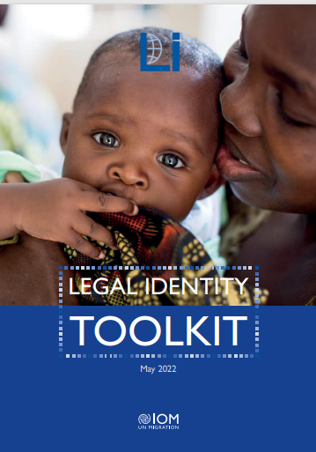
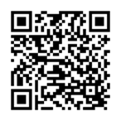
LI Strategy Pillars
1. Supporting development of consular civil registration, citizenship certificates, ID and travel document issuance services
2. Assisting migrants without proof of legal identity
3. Supporting national civil registration and identity management systems to facilitate regular migration and mobility
4. Provide thought leadership on the nexus between migration, displacement, and legal identity including their impact on the protection of migrants
Available: ARA/ENG/FRE
The Toolkit provides guidance to migration practitioners on the operation of national legal identity systems and the frameworks for operationalization of legal identity, including thematic guidance, checklists, templates, and forms.
Discuss key operational issues, such as civil registration services, interoperability, privacy and data safeguards, and travel document issuance services as well as overviews and strategies for improvement of legal identity ecosystems.
Available: ARA/ENG/FRE

Slide 3
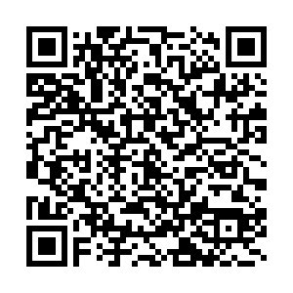
Objective:
Contribute to the realization of the rights of migrants and their children by facilitating their access to legal identity, without putting them at risk (protection of the most vulnerable).
Methodology:
Participatory field research in selected pilot countries (Bosnia and Herzegovina, Brazil, Moldova, Niger, Peru and Thailand) to collect and promote good practices worldwide of how states determine legal identity of migrants without proof of identity, in collaboration with academia and other civil society partners who are active in the area of legal identity in the selected pilot countries.

Slide 4
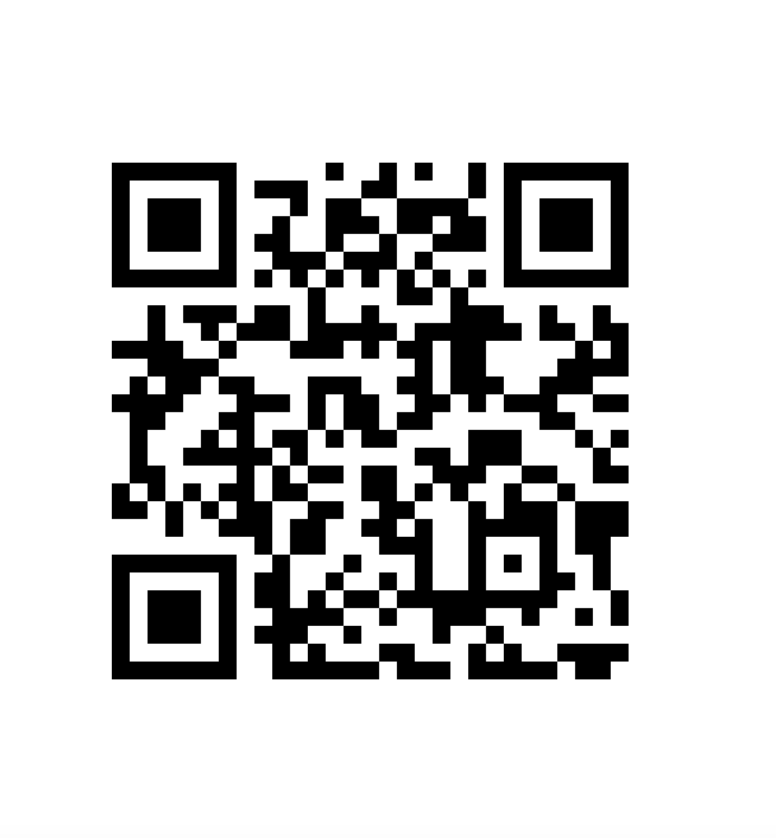
HOLISTIC APPROACH
The IOM Biometrics Manual, shall cover (non-extensive list):
Non-discrimination policies & Technologies,
Legal framework: data protection and human rights,
Cybersecurity
Infant / elder biometrics,
Biometrics databases (type and maintenance)
Outlook on new advancements
Next Steps: Capacity development and facilitators guide
Available: ARA/ENG/FRE/SPA
User-centric guide
Issuing authorities
Verifiers of identity documents / BM Agencies
IBM RTS’s and Project Managers
…for countries
Regions already discussing FMZ cooperation
South-South
Next Steps
Vol.2 & Capacity Building
Available: ENG

