Slide 1
Guidance note on reinforcing CRVS and maternal and perinatal deaths surveillance and response (MPDSR) systems interlinkages in development and humanitarian settings
Name of presenter:
Willis Odek, UNFPA Arab States Regional Office

Slide 2
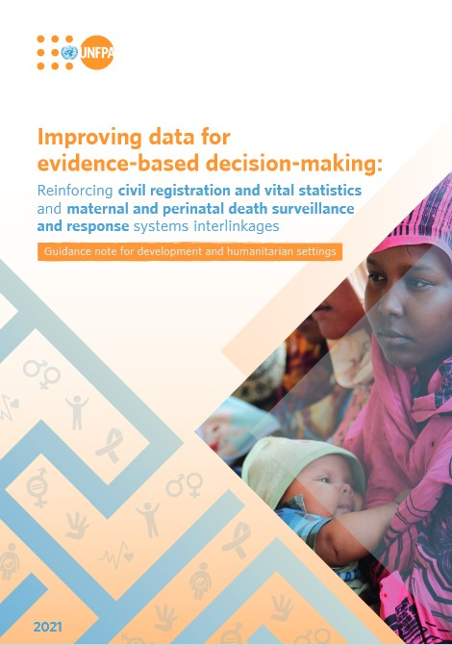
Background
1: Name of the implementation guideline: Guidance note on reinforcing CRVS and maternal and perinatal deaths surveillance and response (MPDSR) systems interlinkages in development and humanitarian settings
2: Objective and purpose of the guideline:
Practical guidance for assessing if the basic requirements for effectively linking CRVS and MPDSR systems are in place, including in humanitarian settings
Outlines requirements and processes for strengthening CRVS and MPDSR data integration in both development and humanitarian settings.
Intended for use during discussions with national counterparts on the design and implementation of CRVS/MPDSR linkage initiatives

Slide 3
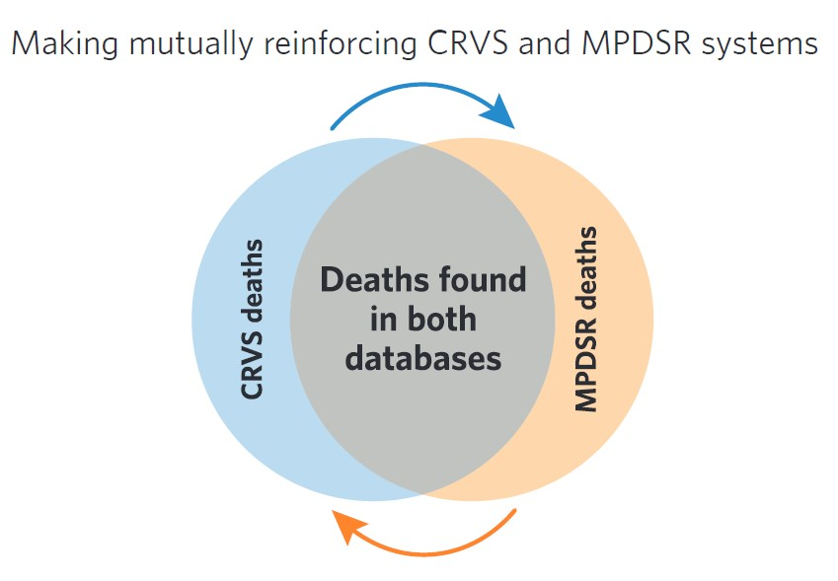
CRVS and MPDSR interlinkages
3: Expected outcome from application of the guideline: Enhanced linkages and data integration between CRVS and MPDSR, particularly in humanitarian settings
mmmm
Deaths to women of reproductive age and perinates in CRVS (but not in MPDSR) provide more complete register of deaths to be investigated by cause
MPDSR can strengthen the CRVS system by identifying deaths not registered, hence provide a more holistic picture of registration completeness and mortality

Slide 4
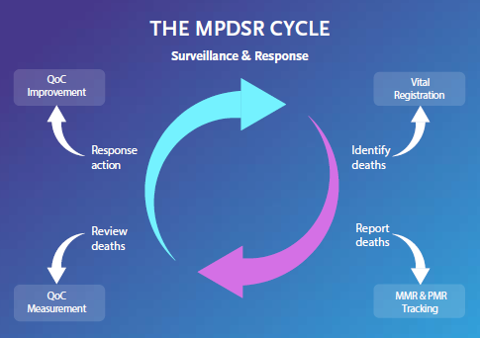
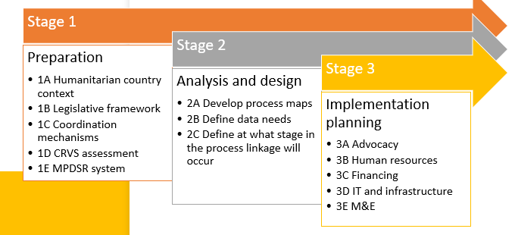
Core contents of the guidance note
4: Outline of key topics that the guideline addresses
Humanitarian contextual factors
Political instability
Livelihood uncertainty
Health system constraints

Slide 5
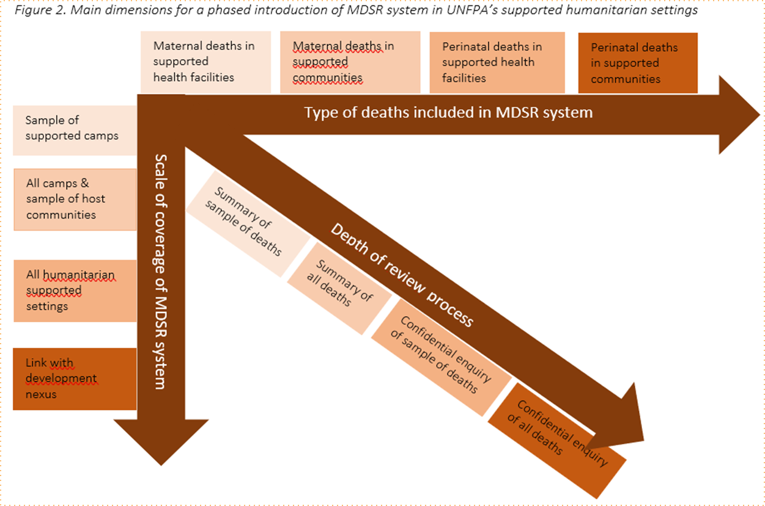
Methodology of implementation
5: Methodology of implementation
Figure: Main dimensions for a phased introduction of MDSR in UNFPA supported humanitarian settings

Slide 6
Related guidelines
6: Related guidelines/ guidelines that compliment the guideline
WHO. (2021) Maternal and perinatal death surveillance and response: materials to support implementation. https://www.who.int/publications/i/item/9789240036666
IAWG.(2018) Interagency Field Manual on Reproductive Health in Humanitarian Settings. New York, IAWG. https://iawgfieldmanual.com/
7: Example of country use cases and outcomes:
Somalia; Sudan – situation analysis
Syria; Afghanistan – situational analysis

Slide 7
