Slide 1
Strengthening collection of cause of death information
Hillary Kipruto
WHO

Slide 2
Content of presentation
Some Key consideration for improvement Strengthening collection of cause of death information
Technical resources available

Slide 3
Some Key consideration for improvement of improvement Strengthening collection
Review of the data collection processes and systems
Revision/Review/ development of the recording and reporting tools
Data collection and transmission capacitates
Medical certification of cause of death
Training on verbal autopsy systems
Automation of processes using digital tools such as DHIS2, EMRs
Adoption of data analysis tools

Slide 4
Data collection a case of EMRs and DHIS2
National Data Centre
MoH
DHIS 2
Central Statistics Office
Identity management Server (MoHA)
Generation and use of data at facility level
Omang Demographic info
EMR1
EMR2
EMR3
Data standards and coding tools: ICD 11, ICHI, ICF, and others

Slide 5
Mortality Report
click on ‘Mortality ’ and select where death occurred in the village or home

Slide 6
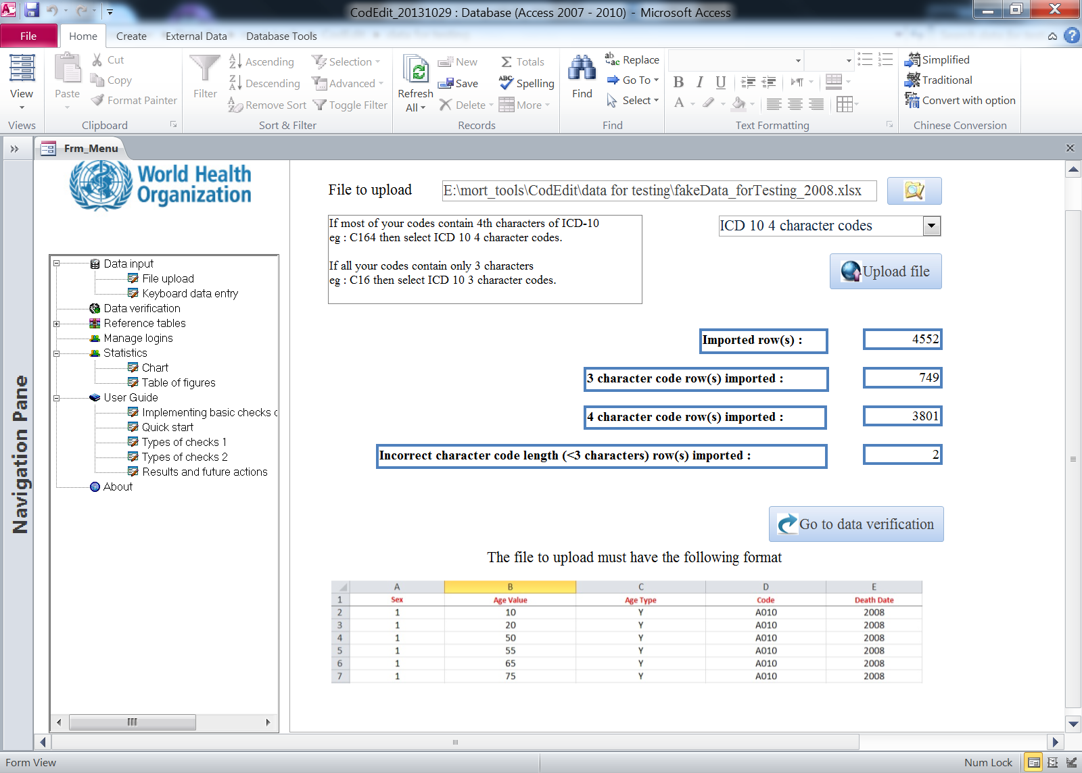
CoDEdit builds capacity to perform routine checks
Tool is an MS ACCESS -based application
Tool is automated so knowledge of MS ACCESS is not required.
Basic understanding of ICD-10 is needed
Who can use this tool?
Producers of mortality data who want to improve their data consistency by checking and correcting the errors
Types of Data that can be verified
civil registration data
hospital cause-of-death data
survey data on mortality
CodEdit tool

Slide 7
ANACoD V3
The ANACOD tools is design:-
To perform a comprehensive and systematic analysis of mortality and cause of death data.
To enhance the value and usability of these data for informing health policies and programmes.
Analysing mortality levels and causes-of-death (ANACoD)

Slide 8
About ANACoD V3
Tool is an online tool which is a web-based application
Only knowledge is upload data to CoDEdit.
Basic understanding of ICD-10 or 11 is needed
All analyses are automated to tabulates data and presents basic mortality measures in the form of tables and figures.
example
Anacod3 generates indicators that reveal potential data quality issues, as well as an array of demographic and epidemiological indicators including sex- and age-specific mortality rates, crude death rates, life expectancy at birth, causes of death distributed by global burden of disease categories, leading causes of death, and the percentage of ill-defined causes of death. For ICD-10 data, the tool conducts an in-depth analysis of external causes of death

Slide 9
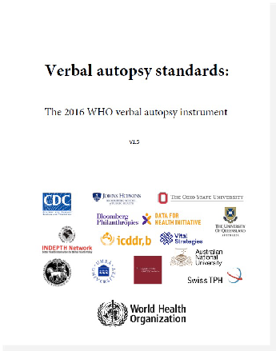
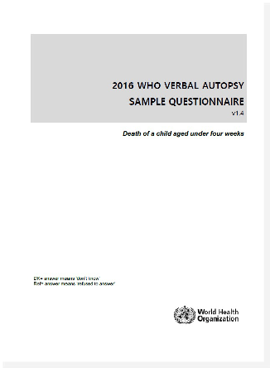
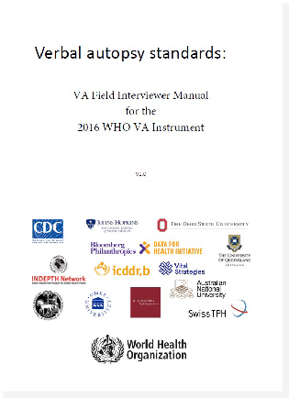
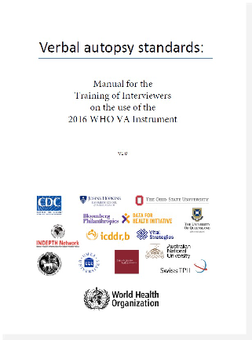
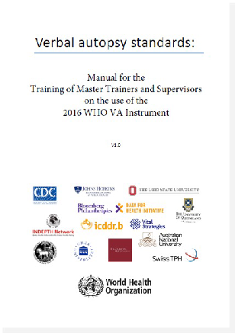
Resources for the WHO 2022 instrument
More than 15 years of development
Questionnaire
Interviewer manual
Trainers manual
Supervisors’ manual
https://www.swisstph.ch/en/about/eph/household-economics-and-health-systems-research/whova

Slide 10
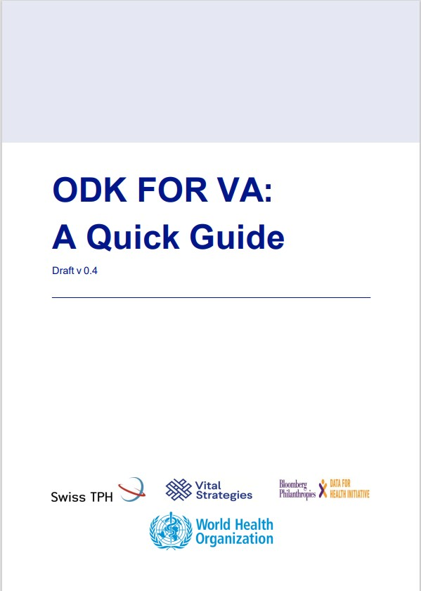
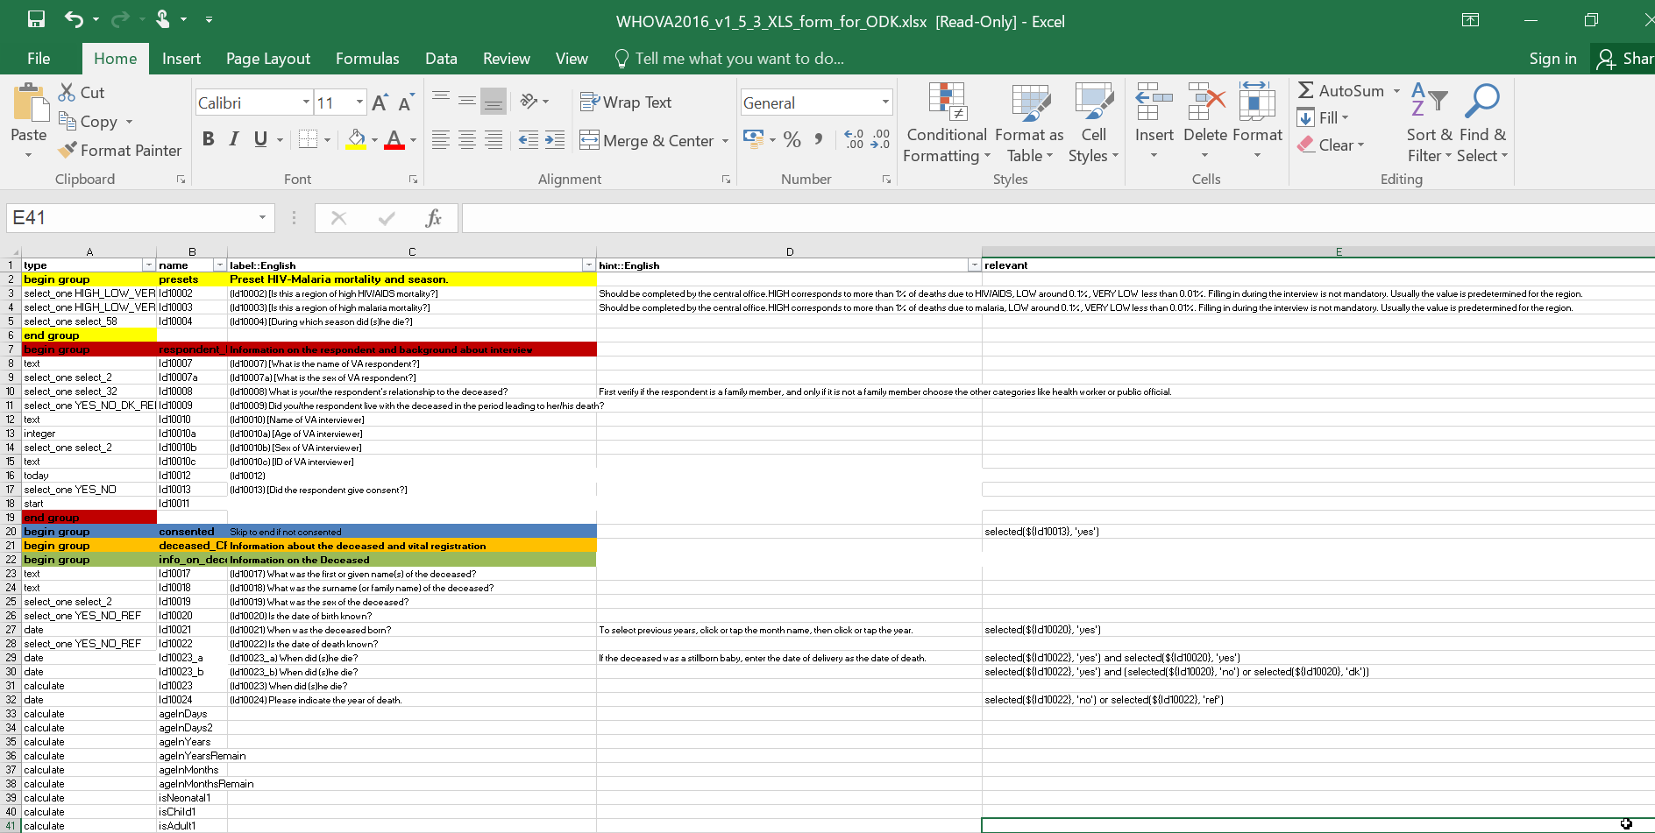
Resources for the WHO 2022 instrument
More than 15 years of development
Questionnaire & XML
ODK version of the questionnaire

Slide 11
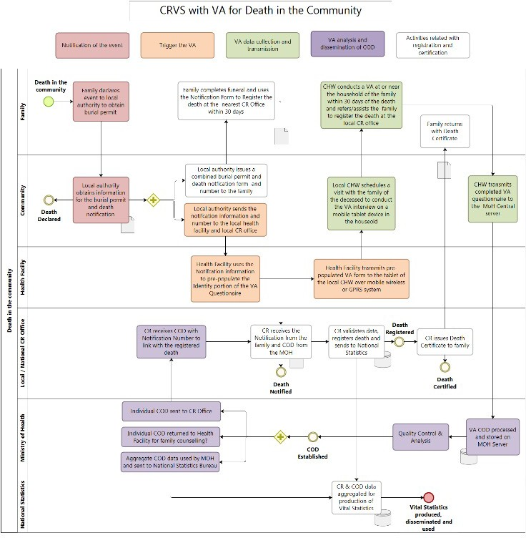
Resources for the WHO 2022 questionnaire
More than 15 years of development
VA costing tool
Integration with OpenVA
Process integration for verbal autopsy
VA sampling tool

Slide 12
ICD-FIT coding training tool
https://icd.who.int/icdfit/login.php

Slide 14
Potential for DORIS integration
Integration with existing tools, in particular the DHIS2: either automatic completion or preference control (to leave the physician free to choose)
MCCD
Data tables
Coding
Physician
Automatic upload
Confirmation of the underlying cause
Physician
Physician
EMR
DHIS 2
DORIS

Slide 15
Technical Resources available
Data collection and analysis tools
Civil registration and vital statistics (CRVS)
Data quality assurance (DQA) - World Health Organization (WHO)
2022 WHO verbal autopsy instrument
WHO 2016 medical certificate of cause of death

Slide 17
Strengthening collection of cause of death information
Name of presenter: James Mwanza
Vital Strategies

Slide 18
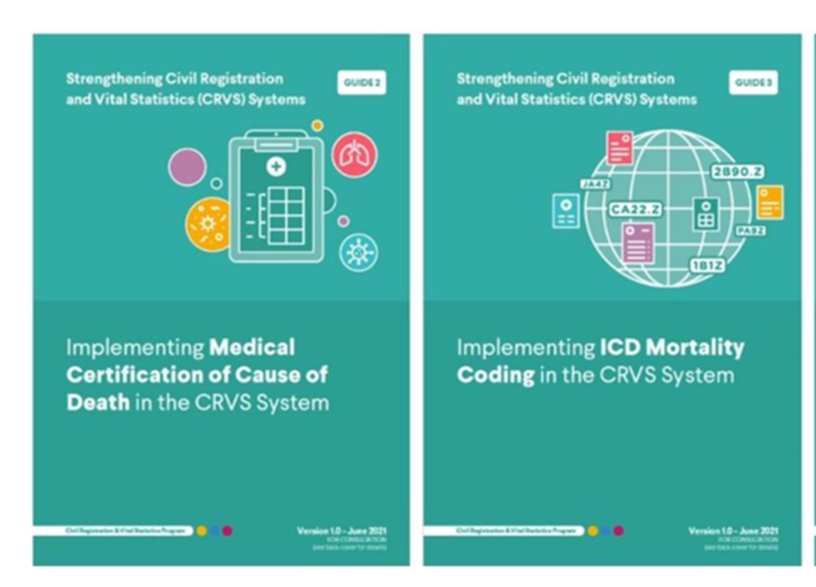
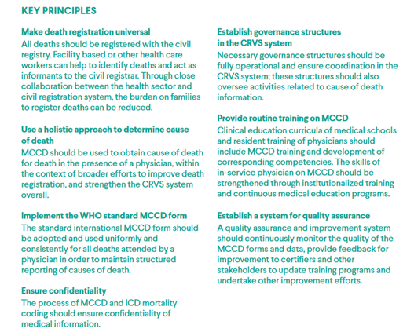
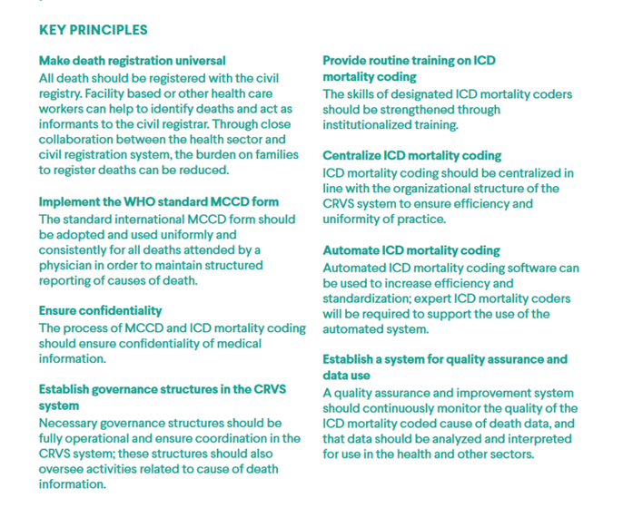
Operationalizing MCCD and ICD Mortality Coding integrated in CRVS System
Outlines practical steps and considerations of MCCD implementation integrated into CRVS systems
https://www.vitalstrategies.org/wp-content/uploads/Strengthening-Civil-Registration-and-Vital-Statistics-Guide-2.pdf
https://www.vitalstrategies.org/wp-content/uploads/Strengthening-Civil-Registration-and-Vital-Statistics-Guide-3.pdf

Slide 19
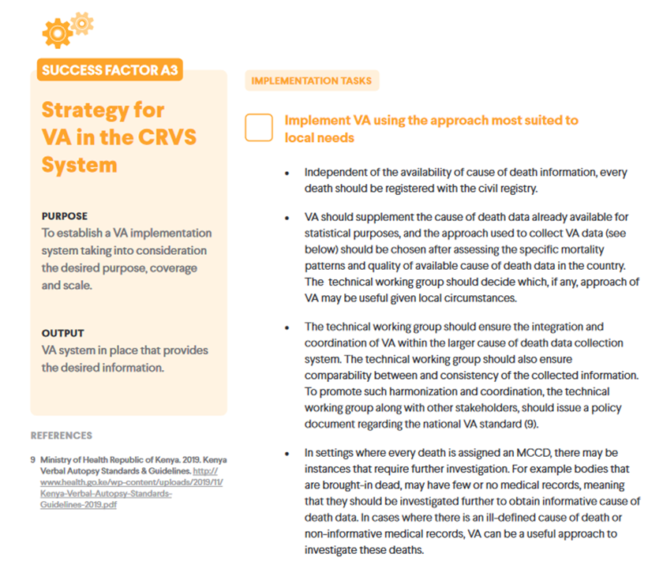
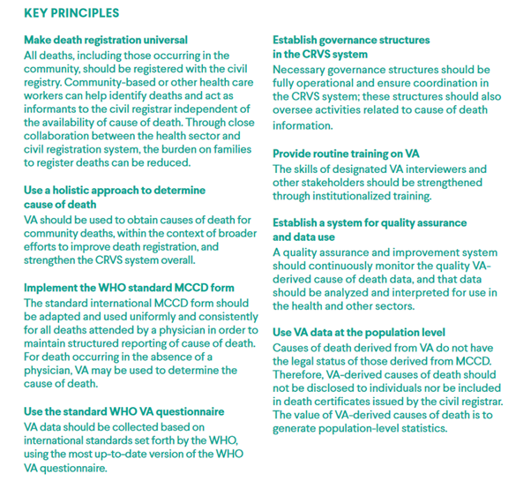
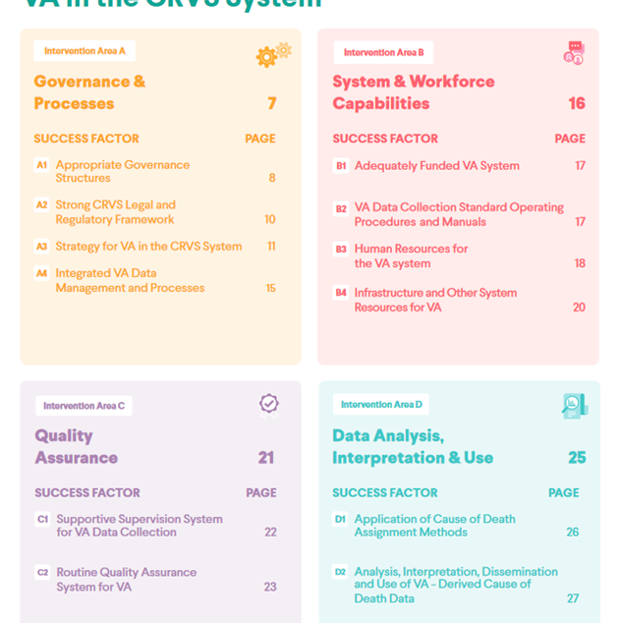
Operationalizing VA Implementation integrated into CRVS System
Outlines practical steps and considerations of VA implementation integrated into CRVS systems
https://www.vitalstrategies.org/wp-content/uploads/Strengthening-Civil-Registration-and-Vital-Statistics-Guide-4.pdf

Slide 20
Collection and Processing of COD in CRVS
Describe key steps and practices for the collection, sharing, and use of COD data in the CRVS systems
Outline processes to achieve the following goals:
Goal 1: All deaths are officially registered and have a medically certified cause of death.
Goal 2: A national-level entity generates vital statistics on all-cause and cause-specific mortality by age, sex and location.
Goal 3: Cause-of-death data is shared in real time for public health purposes.
(Upcoming publication.)

Slide 21
Implementing MCCD and ICD Mortality Coding Quality Assurance and Improvement
Describe the recommended range of interventions to ensure MCCD and ICD mortality coding quality:
Governance structures
Routine quality checks
Job aids
Capacity building
Compliance measures
(Upcoming publication.)

Slide 22
Use Case and Outcome’s
Technical implementation guide | Countries | Outcome’s
Operationalizing MCCD and ICD Mortality Coding Integrated into CRVS System | Tanzania, Rwanda, Kenya, Senegal*, Cameroon*, Ethiopia, Zimbabwe, Ghana, Zambia, South Africa etc. | Institutionalized MCCD training for pre-service and in-service health professionals. Improved quality of MCCOD data. Introduction of routine VA. implementation for community COD determination. Institutionalized mechanism for coordination reporting COD data.
Operationalizing VA Implementation Integrated into CRVS System
Collection and Processing of COD in CRVS | “upcoming”
MCCD and ICD Mortality Coding Quality Assurance and Improvement | “Upcoming”

Slide 23
Existing Technical Resources: Strengthening Cause of Death Information
Brian Munkombwe
CDC

Slide 24
Guidance on MCCD guides with WHO standards

Slide 25
MCCD online Quick Reference Guides and Apps

Slide 26
www.deathcertification.org
Notes:
South Africa has a well-established CRVS system, but the quality of mortality statistics that are obtained from the death notification forms completed by medical doctors is still suboptimal. A reason for this is the lack proper training of medical doctors on the medical certification of cause of death and their poor understanding of how this data is used. We sought to address this issue by developing a free online course based on the ICD principles of identifying the UCOD, and that is compatible with the death notification form used in South Africa. This course is based on the same concept used by the NYC course.

Slide 27
MCCD Online Training
Free SA MRC online training course
User-friendly platform
Self-learning at own pace
Compatible with different devices
Voice-over recordings
Downloadable pdfs
5 modules
case scenarios
Working with MRC and WHO Afro to redesign the course for Regional Audience

Slide 28
Guidance on MCCD quality Assessment
This contains a set of simple questions for checking common MCCD completion errors to assess the cause of death certification practices.
Assesses errors like:
Multiple causes per line
Use of Abbreviations
Incorrect or clinically improbable chain of events
etc…

Slide 29
Guidance on ICD coding and automated (IRIS) Coding
It describes seven key steps that countries should follow when implementing automated mortality coding:
Information gathering and process mapping
Mapping of Iris processes
Data dictionary and Standardization tables
Trainings
Rejected tables
Sustainability
Evaluation

Slide 30
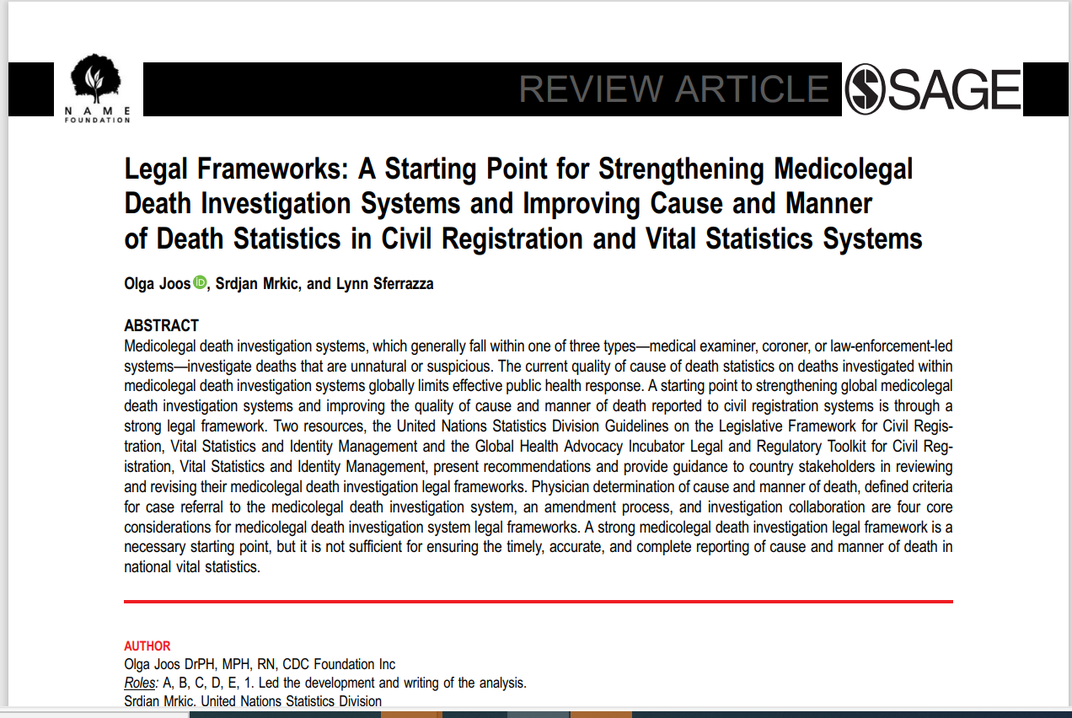
Other Technical Resources
Medicolegal Death Investigation System (Guidance under development)

Slide 31
Other Resource Technical Tools under Development
Guidance on the Analysis of Verbal Autopsy (VA) and Medical Certificate of Cause of Death (MCCD) Data
Tool for HIS/CRVS data to ANACOD3 export script to auto populate template
DHIS2 ICD11 DORIS app ( under development)
MCCD eLearning Course (with SA MRC and WHO Afro)

