Slide 1
Africa’s Progress Towards SDG target 16.9: Legal Identity for all including birth registration
William Muhwava
Chief, Demographic and Social Statistics
African Centre for Statistics

Slide 2
Our Flagship Programs
APAI-CRVS
To provide management and programmatic guidance to the regional agenda of reforming and improving CRVS systems. Specifically, the regional programme provides guidance on the institutional and operational linkages, workflows and results management mechanisms in a more comprehensive and holistic manner, encompassing the inter-disciplinary and inter-sectoral interfaces of CRVS systems
United nations Legal Identity Agenda (UN LIA)
Holistic approach to civil registration of all vital events, production of vital statistics, the establishment and maintenance of population registers and identity management apparatus from birth to death, with full interoperability between these functions in a simultaneous manner, according to international standards and recommendations and in compliance with human rights of all people concerned, including the right to privacy.

Slide 3
Reflecting on the APAI-CRVS 2010-2024
Endorsement of regional work plan (2010-2015)
Recommendation for CRVS system assessments
Recognition of end of 2010-2015 work plan and progress thereof
Launch of Africa CRVS decade (2015-2024) and day
Series of webinars on management of CRVS systems during the pandemic
Introduction of the CRVS improvement framework
3rd CRVS day celebrations
Meeting of Permanent Secretaries
New Initiatives –Evidence Based Interventions
Directives to Pan African institutions to provide regional leadership
EGM of CRVS focal points
Celebration of 1st Africa CRVS day
.
CRVS assessments and development of action plans
COM6 Experts segment
2022
2023
2024
2010
2011
2012
2013
2014
2015
2016
2017
2018
2019
2020
2021
CRVS mentorship programme covering selected countries .
Guidance on management of Covid-19
COM6 Experts Segment
New Strategic Plan
2023 -2028
Integration
Digitization
Decentralization
Establishment of CRVS secretariat
Establishment of CRVS core group
APAI-CRVS work plan developed
Training of a pool of experts to support CRVS system assessments
Support to countries to conduct assessments and develop action plans.
Launch of the post 2015 agenda and specific goals on CRVS
Africa mortality statistics strategy
CRVS assessments and development of action plans
Review and endorsement of the new APAI-CRVS strategic and work plan (2017-2021)
Launch of CRVS regional monitoring form
Initiative to formalize committee of registrar generals
Launch of UN legal identity agenda
Declaration on need for integrated CRVS -ID systems

Slide 4
African CRVS Systems vs The Principles
Fulfilling the Definition
Continuous – Yes, available on demand
Permanent – Stationary and Mobile facilities established but mostly reactive and passive
Compulsory – Laws exist but lack enforcement
Universal – Ranges from very low to universal
Recording of the occurrence and characteristics of vital events pertaining to the population
As provided through law, decree or regulation in accordance with the legal requirements of the country
Primary purpose – establishing documents provided by law – Legal frameworks exist in all African countries although some are outdated based on colonial laws
Secondary purpose – ideal source of vital statistics – Partial
Foundation of national identity system – Partial since the largest proportion of invisible people is in Africa.

Slide 5
CRVS Activities Led by APAI-CRVS Secretariat
CRVS System Improvement
CRVS and Gender (CB-GenSMS) Project
Application of the Business Process Improvement Framework
Training pool of experts on BPI
CRVS with a Gender Dimension in Burundi and South Sudan expanding to 6 countries with $4mil
Mentorship Program
CRVS Applied Research and Training Program (CART)
Focal persons based in the countries who are fully trained in CRVS process improvement – 13 Countries
Capacity building of national experts to undertake research
Production of research papers for publication
First cohort with 25 researchers
Policy Briefs based on CRVS
Teenage pregnancy
Cause of Death Profiles
Impact of Covid-19 on Mortality
Inequality Assessments
Analysis of census data on vital events registration and certification (12 countries)
Classification and Regression using DHS data to show vital events not being registered
CRVS Digitization
Guidelines on digitalization of CRVS systems
African eCRVS Shared Asset (ACSA)
Working Group on CRVS Digitization
Notes:
ASS: African Statistical System
NSS: National Statistical System

Slide 6
Pillars to Increase Coverage in the New Strategic Plan

Slide 7
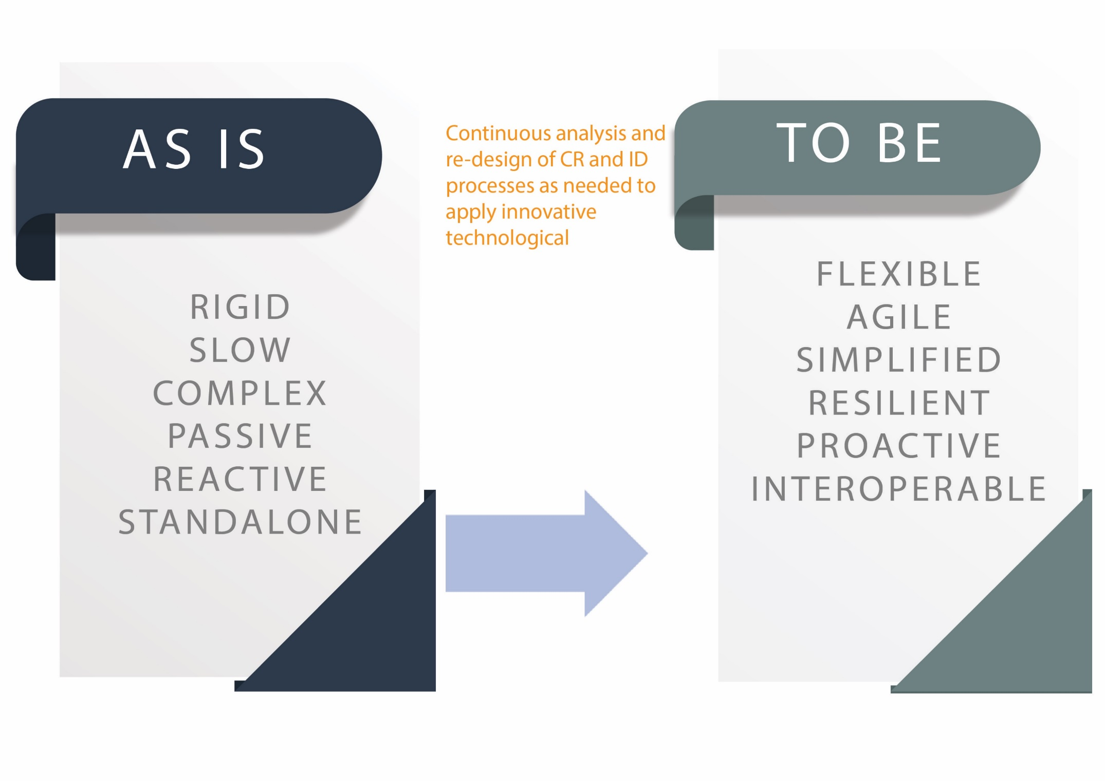
Development of CRVS & ID Systems that are Fit for Purpose

Slide 8
Way Forward……to Increase Coverage and Meet Our SDG Target
Through Ministerial Conferences, advocate for the political will and commitments to provide and adequately fund civil registration as public good and service
Member States to put in place institutional capacity building amongst relevant line ministries and departments to better, plan, budget, advocate and scale up delivery of legal documents
Member States to provide adequate infrastructure, supply and logistics chain to support service delivery
Interoperable and integrated systems between services where vital events occur (hospitals & community) with registration systems
Communities have access to information and knowledge about the availability and benefits of services

Slide 9
Resources Developed by APAI-CRVS to Improve CRVS & ID Management

