Slide 1
Africa’s Progress Towards SDG 16.9: Legal Identity for All including birth registration
Karin Heissler
Child Protection Regional Adviser
UNICEF Regional Office for West and Central Africa
Universal Birth Registration

Slide 2
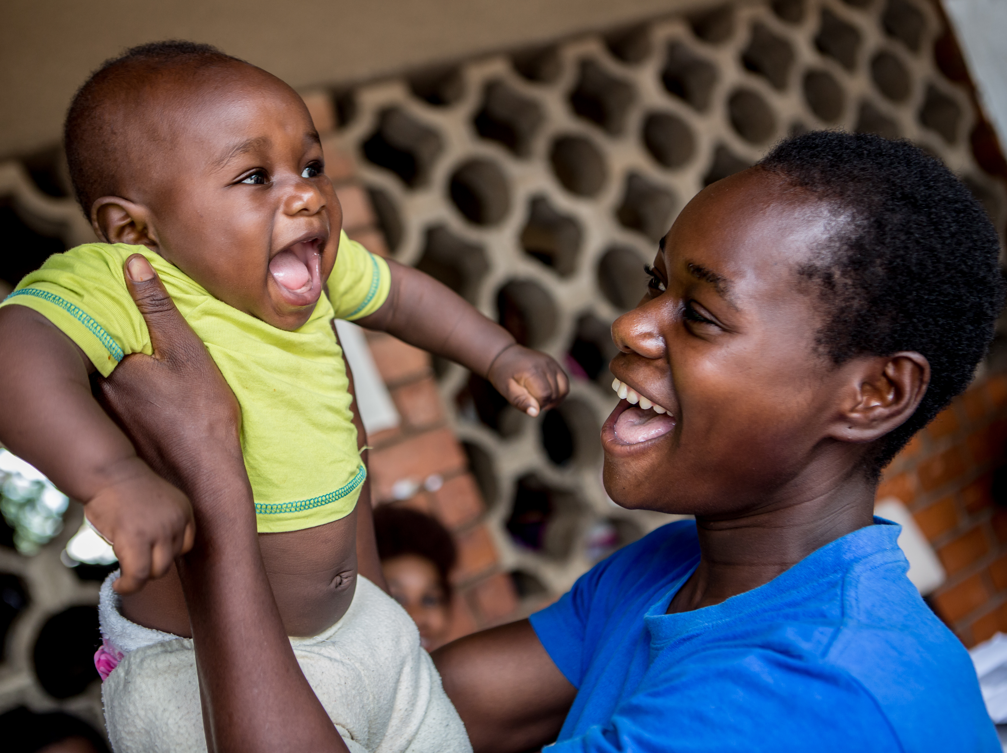
The right to be registered at birth and to have an identity
The Convention on the Rights of the Child (Article 7 and 8)
African Charter on the Rights and Welfare of the Child (article 6)
Birth registration is the first official recognition of a child's existence and gives the child a legal identity
Birth registration is the gateway to the enjoyment of all children’s rights
Without a legal identity, children remain invisible, unprotected, and at heightened risk of statelessness
not even reported.
© UNICEF/UN0152973/Schermbrucker
Notes:
Eastern:
Southern:

Slide 3
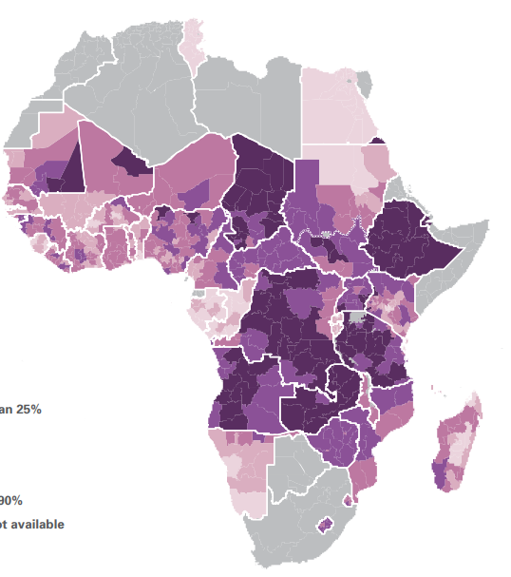
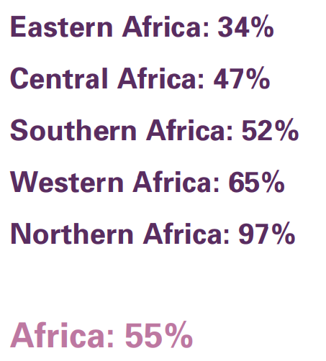
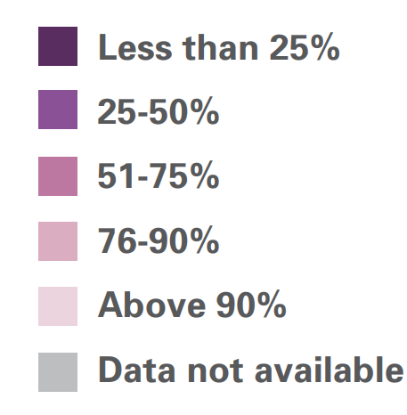
SDG target 16.9. By 2030, provide legal identity for all, including birth registration
Percentage of children under age 5 whose births are registered in Africa by region and subnational areas
Globally, the births of one in four children under 5 have never been officially recorded (164 million). More than half (around 91 million) live in Africa.
20 countries in the continent are on track to achieve universal birth registration by 2030 while 23 countries will need to accelerate progress.
Source: UNICEF, A Statistical Update on Birth Registration in Africa (New York, 2022).
Notes:
Globally, the births of one in four children under 5 have never been officially recorded (164 million). More than half (around 91 million) live in Africa. 20 countries in the continent are on track to achieve universal birth registration by 2030 while 23 countries will need to accelerate progress.
We understand that this is a lagging indicator, mostly relying on national HH surveys, with some data going back quite a few years. Nevertheless, one thing is clear: that the world will not achieve SDG 16.9.1 unless we make progress in these regions.

Slide 4
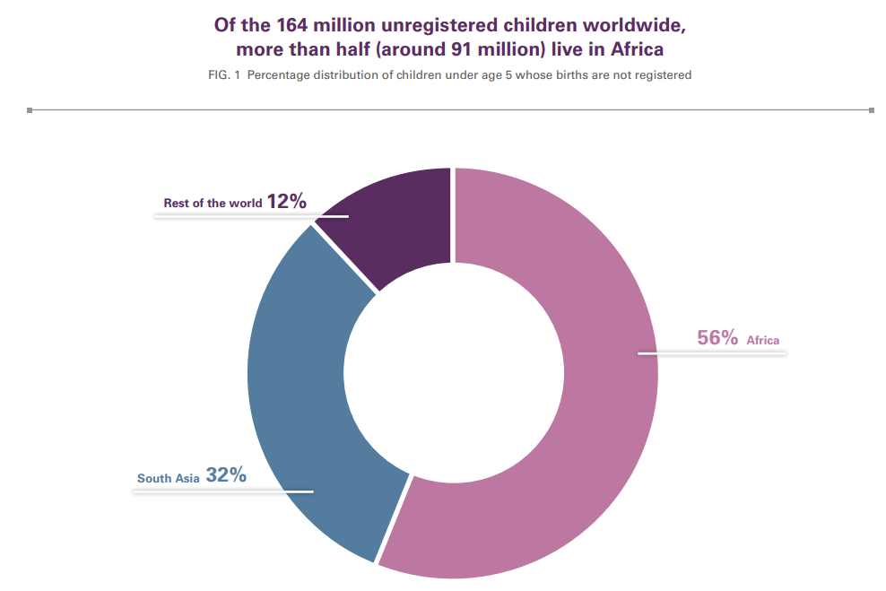
Six countries
Nigeria
Ethiopia
DRC
Pakistan
Bangladesh
India
account for HALF of all unregistered children globally
Source: UNICEF Data, 20..
Source: UNICEF, A Statistical Update on Birth Registration in Africa (New York, 2022).
Notes:
Eastern:
Southern:

Slide 5
Regional context: Current U5 registration
In Africa,
more than half of unregistered U5 children - 52 million -
live in East and Southern Africa
Number of children under age 5 whose births are not registered, by African region:
Source: UNICEF, A Statistical Update on Birth Registration in Africa (New York, 2022).
Notes: Figures have been rounded. Estimates are based on a subset of 50 countries in Africa covering 98 per cent of the population of children under age five. Regional estimates represent data from countries covering at least 50 per cent of the regional population.
Notes:
Eastern:
Southern:

Slide 6
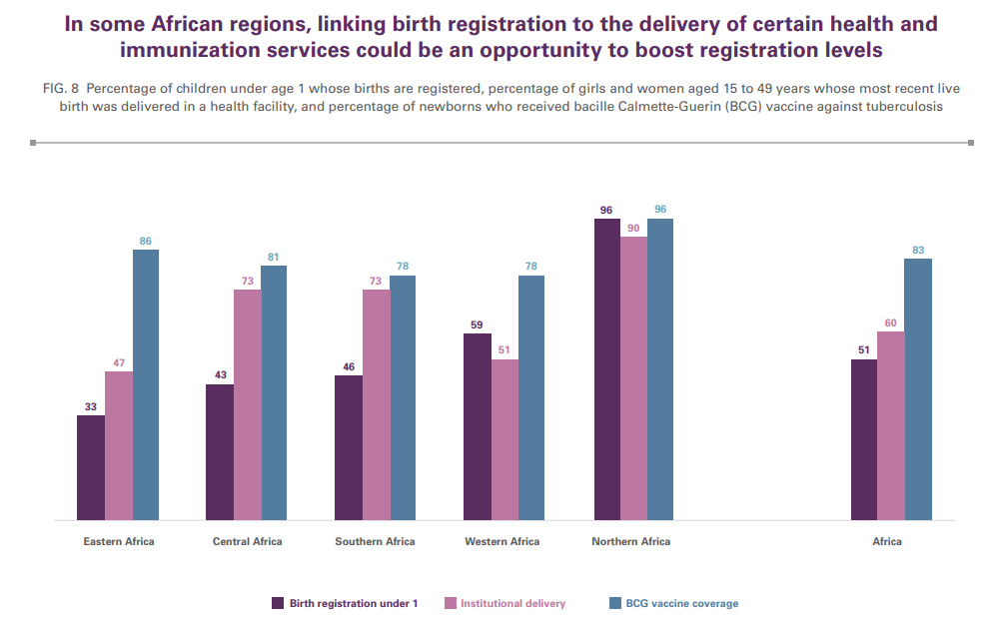
The Opportunity
Source: UNICEF, A Statistical Update on Birth Registration in Africa (New York, 2022).

Slide 7
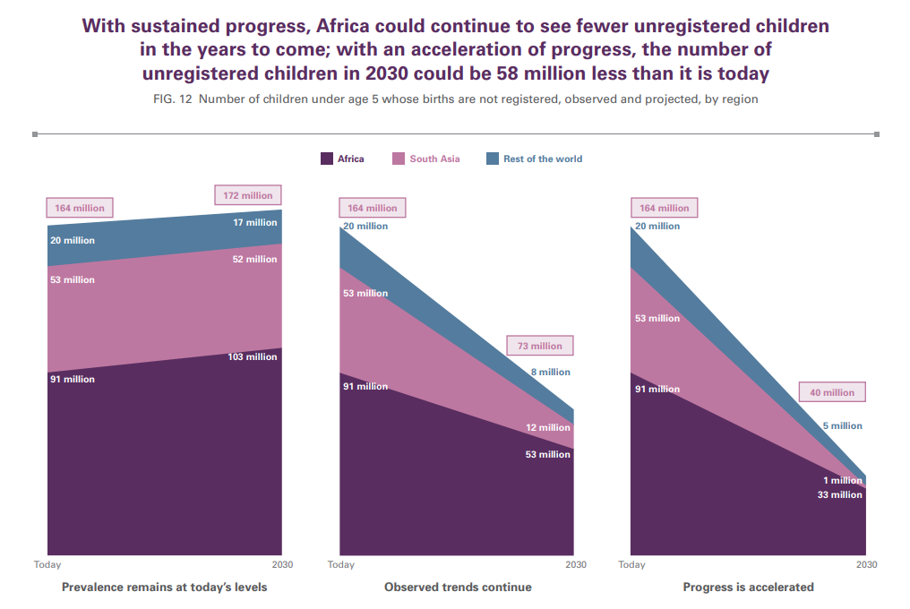
Needed Acceleration
Source: UNICEF, A Statistical Update on Birth Registration in Africa (New York, 2022).

Slide 8
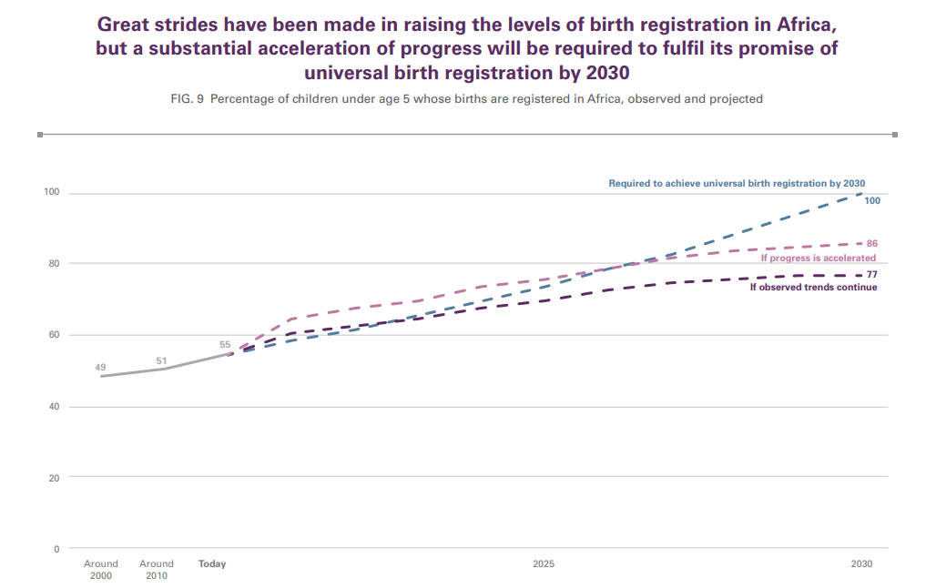
Needed Acceleration
Source: UNICEF, A Statistical Update on Birth Registration in Africa (New York, 2022).

Slide 9
Top three bottlenecks to universal birth registration
Discriminatory laws and practices
Accessibility and insufficient decentralization of services and affordability (direct and indirect cost)
Complicated (multiple-step) birth registration processes (particularly for late registration) and missed opportunities for integration with other services
Notes:
Eastern:
Southern:

Slide 10
Game-changing evidence-based solutions
1. Twinning (or interoperability) of health and civil registration, with a nexus approach
register the child where it is born – through the health facility or the community health services
2. Decentralization
decentralized and scaled for registration of all newborns at hospitals, health centres, communities
3. Use of innovative, safe, and cost-effective digitalization
move data, not people
Additionally, countries need to ensure birth registration and certification is free of charge for all children 0-17, without discrimination and with a humanitarian-development nexus approach

Slide 11
Recommendations and policy direction
(aligned with evidence-based solutions – previous slide)
1. Twinning (or interoperability) of health and civil registration: review legal and policy framework to advance a proactive approach
adopt a 'one-stop' approach to birth registration and certification through health and immunization services
2. Decentralization
Mobilize sub-national authorities for full decentralization of services (linked to interoperability)
3. Promote innovative, safe, and cost-effective digitalization
Pursue a gradual approach to digitalization
To ensure birth registration free of charge for all children 0-17, countries need to:
waive fees and fines for late and delayed registration
provide first copy of the birth certificate free of charge

Slide 12
