Slide 1
Africa’s Progress Towards SDG 16.9: Legal Identity for All including birth registration
Dr Benson Droti
Assessing Africa’s progress towards SDG target 16.9
Reporting of Deaths and Cause of Death
World Health Organization, Regional Office for Africa

Slide 2
Introduction
Currently, births and deaths that occur in Africa remain are not registered.
This affects the ability of African countries to understand their population dynamics and adequately plan for them.
African countries therefore have a fundamental responsibility to develop and strengthen the systems and capacities for birth, death and cause of death reporting

Slide 3
Status of birth and death registration (WHO SCORE Assessment, 2020)
Not recent statistics from WHO on the status of birth, death and cause of death reporting
Very poor capacity for CRVS
Up to 30 countries had nascent capacity
Only one country with sustainable capacity
Completeness of birth & death registration: No information; <50%; 50-74%; 75-89%; ≥90%
Quality: No data; At least 30% ill-defined or unknown causes; 20-29% ill-defined or unknown causes; 10-19% ill defined or unknown causes; Less than 10% ill-defined or unknown causes
% of medically certified deaths: No standardized system; <30%; 30-69%; 70-89%; ≥90%
Notes:
These statistics are worrying as they mean that Member States of the WHO African Region are unable to provide adequate information on all births and deaths and circumstances related to them. It also means that the Member States are unable to provide timely insights into how first their population is growing, how population growth differs across different regions of the country, and when, where and why people die.
I imagine that you all know that availability of data on births is fairly high in many African countries because these data can be captured from routine immunization services. Many African countries also require birth certificates for children to access certain services such as school enrolment.
However, many African countries are doing extremely poorly when it comes death and cause of death reporting.
A recent assessment by WHO, As Dr. Prosper mentioned in his opening remarks, shows that only one country can be described as having fully developed and sustainable capacity for CRVS. Two thirds of the countries had almost nothing going on.
The SCORE assessment also found that about two thirds of the countries in the African region have no information on death registration, cause of death certification, and quality of death certification.
Registration of deaths was fairly complete in only four countries. By fairly complete I mean that at least 90% of the deaths have been registered.
Fairly full medical certification of cause of death was done in only 5 countries. By fairly full I mean that at least 90% of the deaths that occurred in health facilities had their causes certified.
Quality of diagnosis of cause of death is equally very poor. For instance, in five countries that have cause of death information; at least 30% of the causes of are either ill-defined or unknown.

Slide 4
What has changed in the WHO African Region – Regional Level
Stronger inter-partner collaboration – WHO, UNECA, Africa CDC, US CDC, Vital Strategies, UNFPA, IOM etc.
Heightened technical support and training to countries – many of them done through joint efforts
A number of tools, standards and guides developed or updated:
Reference classifications within the WHO-FIC – ICD 11
An ICD 11-based electronic tool for medical certification and coding of causes of death – implemented within the DHIS 2 environment
An online tool for training medical doctors on medical certification of cause of death – based on the principles for completing the international form of the medical certificate of cause of death, which was released in 2016
The DORIS (WHO Digital Open Rule Integrated Cause of Death Selection) tool for an automated selection of the underlying cause of death
ANACOD 3 (Analysing Mortality and Causes of Death 3) – for analysis of mortality data
A brief guide for mortality surveillance – already shared with countries
Africa CDC’s continental framework for mortality surveillance

Slide 5
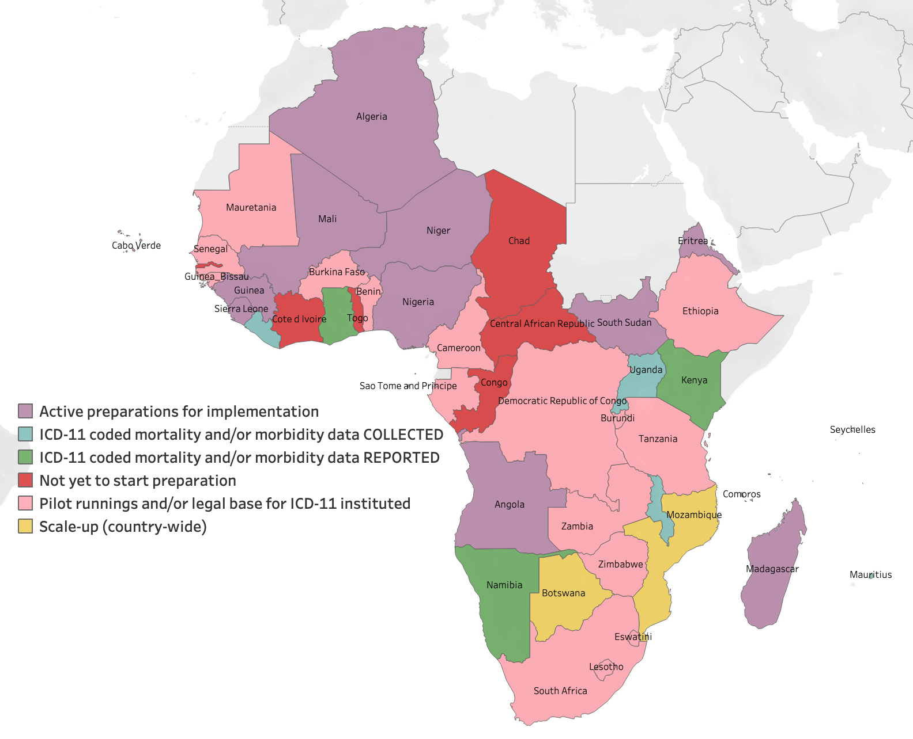
What has changed in the WHO African Region – country level
Greater appreciation of importance of birth, death and cause of death data/information
All countries have put in place systems for reporting births, deaths and causes of death – varied levels of implementation, functionality and performance
ICD-coded mortality reporting
Country-wide scale-up of ICD 11: two countries
Both collecting and reporting ICD-coded mortality and morbidity data: three countries
Collecting (but not reporting) ICD-coded mortality and morbidity data: six countries
Active preparation for implementation: Nine countries
Just starting to implement ICD 11: 16 countries
Not initiated: six countries
WHO is planning to do another assessment of the state of CRVS using the SCORE and comprehensive HIS assessment tool – looking for funds to do this

Slide 6
Where some of the important gaps?
The governance-related challenges:
The lack of or insufficiently enforced legal requirement in many African countries to report a birth or death event, with cause of death information.
Absence of specific policies requiring medical workers to determine and report a cause of death
Limited central or leadership role of the health sector in civil registration and vital statistics systems
Limited investments in CRVS and health information system in general
Challenges related to systems for data and information generation:
Paper-based systems that are cumbersome
Limited capacity to analyse birth and mortality data
**Why should I report a birth or a death event? How do I benefit? – current focus for improving birth and reporting ignores these questions

Slide 7
What should change (1)
For purposes of public health action, countries can start small – in a few sentinel sites, and then gradually increase the sites to produce nationally representative statistics.
For purposes of birth and death registration, countries should focus on improving death notification – with the right legislation and incentive mechanism, it is possible to achieve 100% death notification rate – but mechanisms to enhance access to registration offices should be put in place
Review and update legal frameworks to improve death (and birth) registration and statistics.
Enhance investments in systems for reporting births, deaths and causes of deaths
Enhance the central or leadership role of health ministries in the management of civil registration and vital statistics systems
Ensure that strategic plans, policies and data architecture frameworks are up to date.
Leverage innovations in digital technology

Slide 8
