Slide 1
Existing technical resources: Organization, Management and governance of CRVS systems - Strengthening interlinkage of CRVS and (Digital) Legal ID System-
Risa Arai
UNDP

Slide 2
Guidance Notes
This workshop has three key objectives namely: (i) socialization of country delegates of existing technical guidance on CRVS reform; (ii) identification of gaps and areas in which additional guidance is required by countries; and (ii) validation of recently developed guidance on CRVS reform.
For purposes of this workshop, technical implementation guides are perceived to be documents providing simplified guidance on specific thematic areas. They are by nature concise, written in simple language and offering direct (‘hand holding guidance’) on specific topics. They enrich existing UN guidelines and manuals by providing operational level guidance. They include templates, case studies/examples of successful implementation approaches.
You have been invited to make a presentation about the technical implementation guides developed by your organisation to support CRVS reform. The draft programme provides broad themes under which your guideline could be categorized. You are therefore requested to follow the themes on the programme as an overall guide rather than the specific topic that you should present on.
It is recognized that some organisations may have developed guidelines on the same/ closely related topics. For this reason, you are encouraged to reach out to other partners of the core group that may be presenting on a similar theme, to ensure that your presentations build the relevant synergies.
To provide an opportunity for all to participate and ample time for discussions, please limit your presentation to a maximum of 8 minutes and 5 slides. You are requested to send your slides to the Secretariat by 26th January 2024 to ensure that they are uploaded and available for presentation during your session.

Slide 3
Content of presentation
Name of the implementation guideline
Objective and purpose of the guideline
Expected outcome from application of the guideline
Outline of key topics that the guideline addresses
Methodology of implementation
Related guidelines/ guidelines that compliment the guideline
Example of country use cases and outcomes

Slide 4
Linking CRVS and National ID Management

Slide 5
Guidelines on the Legislative Framework for Civil Registration, Vital Statistics and Identity Management
Objectives:
To offer a tool for developing a strong rights-based legal framework for civil registration, vital statistics and identity management systems.
To offer a consistent and structured basis for performing all the tasks associated with the legal uses of the records of events and identification.
To provide overarching principles and elaborate in detail the legislative framework critical for implementing international recommendations
To recommend and present a framework for integrated systems, where the civil registration system provides input into the vital statistics system and the identity management system

Slide 6
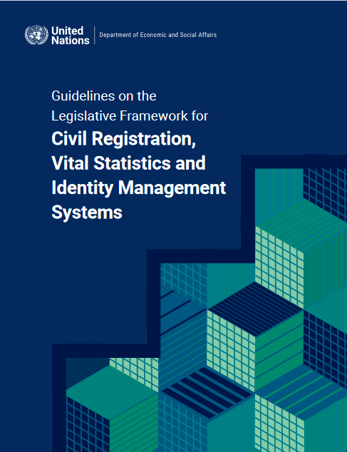
Guidelines on the Legislative Framework for Civil Registration, Vital Statistics and Identity Management
Outlines:
Overview of civil registration, vital statistics and identity management systems
Human rights and civil registration, vital statistics and identity management systems
Institutional arrangements for civil registration, vital statistics and identity management systems
Legislative framework
Other laws and policies that support civil registration, vital statistics and identity management systems: incentives, medical profession training and technology

Slide 7
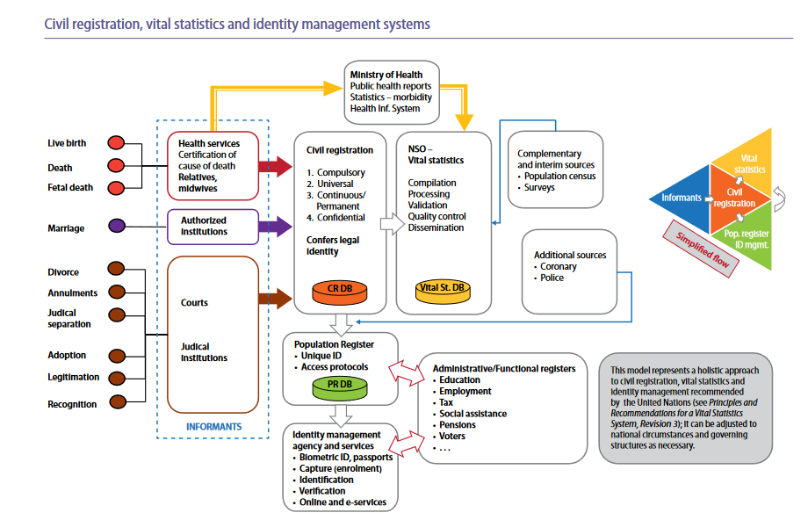
Guidelines on the Legislative Framework for Civil Registration, Vital Statistics and Identity Management
Expected Outcome
Legislative framework that enables the comprehensive and interoperable legal identity ecosystem where CRVS and ID, as well as other functional registries are interlinked with sufficient human rights considerations (such as data protection and privacy).
Use cases
Increasing number of countries are paying effort to connect birth registration and national ID system (Ex. Malawi, Namibia, India, Peru etc.)

Slide 8
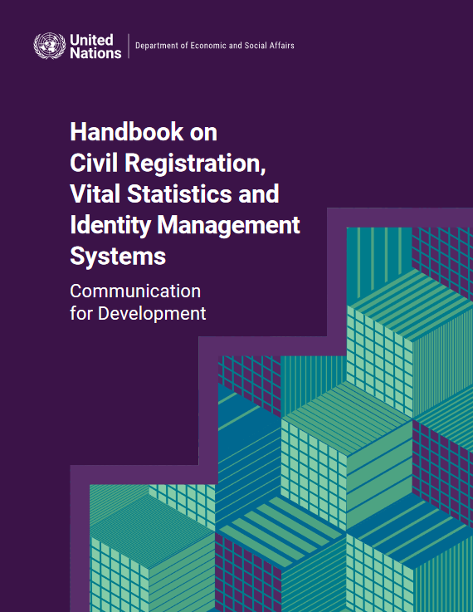
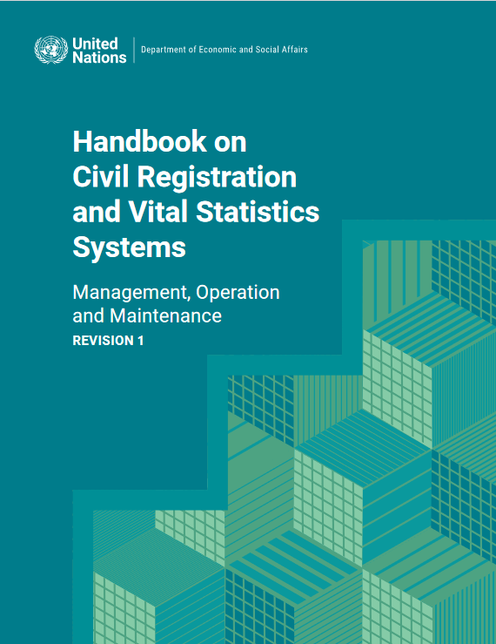
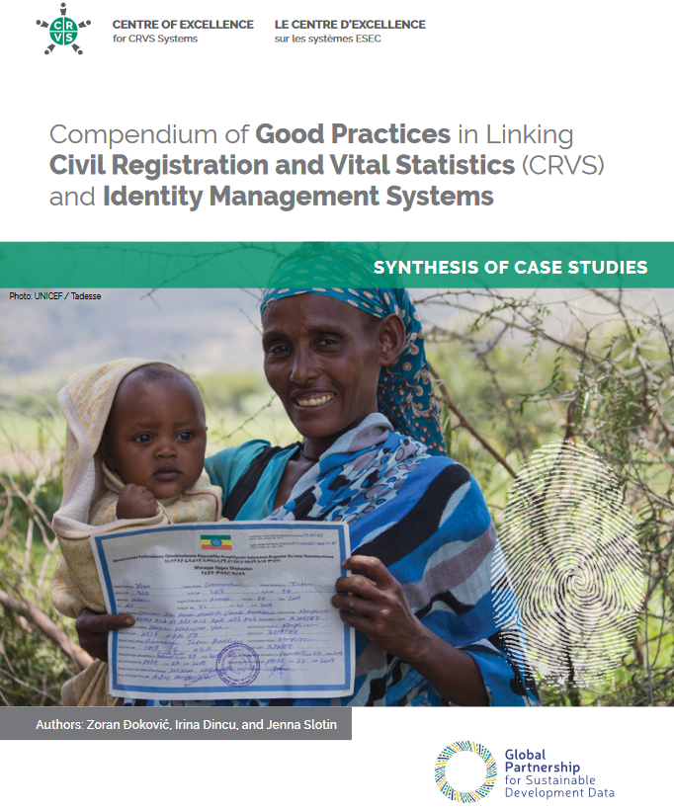
Guidelines on the Legislative Framework for Civil Registration, Vital Statistics and Identity Management
Other Relevant Guidelines/ Resources

Slide 9
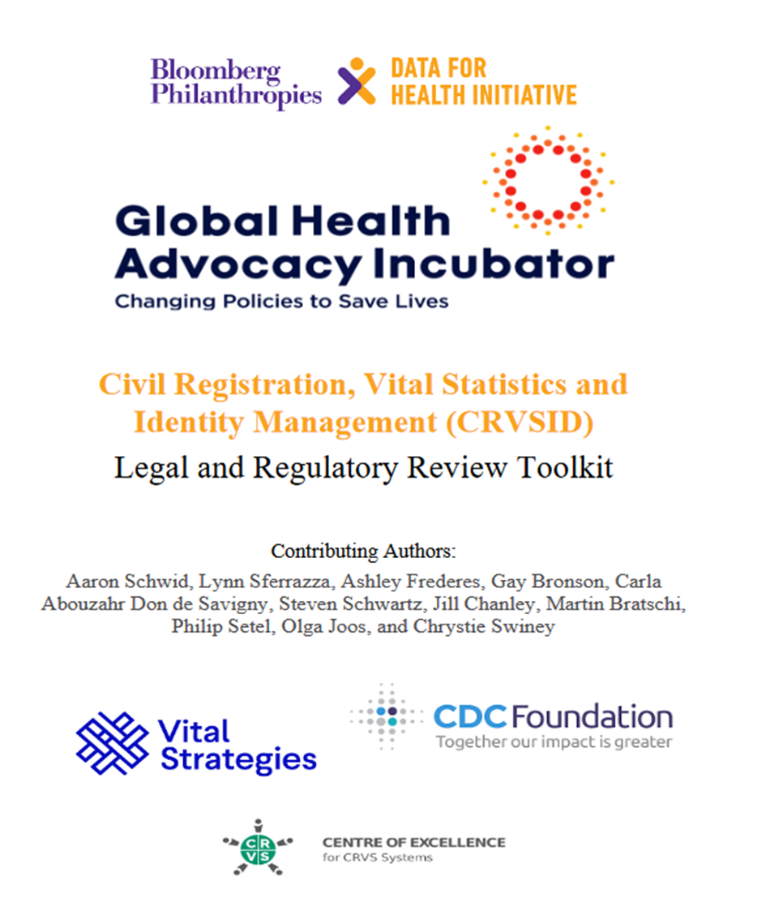
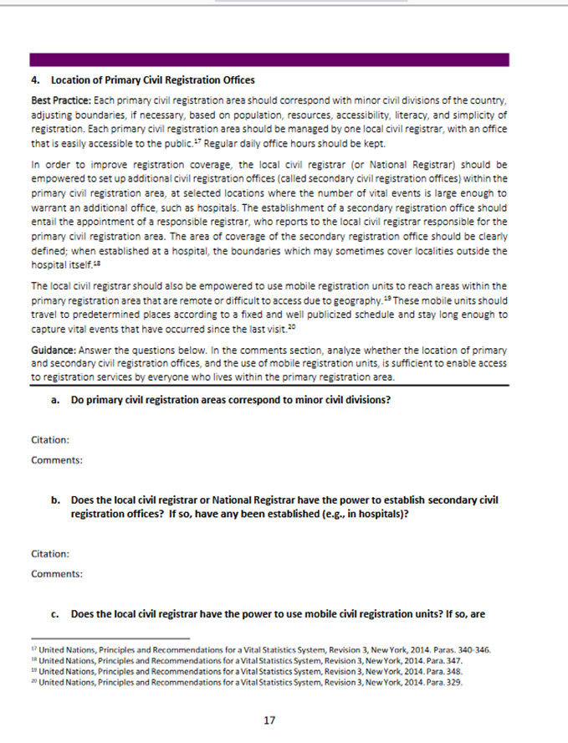
CRVSID Legal Review Toolkit
Provides comprehensive guidance for the review of the CRVSID legal and regulatory framework in core and optional chapters
Outlines the legal review process and enables the comparison of a country's CRVSID legal and regulatory framework to international pest practice to identify the need for revision
Chapter Title
Structure of the Civil Registration Authority
Registration of Birth and Death
Stillbirth Reporting and Registration
Determining and Certifying Cause of Death
Medicolegal Death Investigations
Registration of Marriage and Divorce
Inclusion of Women and Children
Production of Vital Statistics
National ID System
Equal Access for LGBTI Individuals
Population Register
Personal Privacy and Data Protection
https://www.advocacyincubator.org/what-we-do/our-public-health-advocacy-programs/civil-registration/legal-and-regulatory-review-toolkit-for-crvsid

Slide 10
Governance of Digital Legal Identity System

Slide 11
Digital ID has proven an effective enabler for development, but we are not at SDG 16:9
The potential of digital ID…
…and the work ahead for (digital) identity for everyone
3 - 13% GDP growth
850 Mn people
16% more women than men
could be unlocked in individual countries by 2030 from the implementation of digital ID programs³
do not have any official form of identification, and therefore have limited access to public services and economic mobility¹
don’t have access to ID resulting in limited legal status and access to asset ownership²
(1) World Bank, 850 million people globally don’t have ID, 2023; (2) Biometric Update, Massive gender disparities in digital ID systems persist, 2021; (3) McKinsey, https://www.mckinsey.com/capabilities/mckinsey-digital/our-insights/digital-identification-a-key-to-inclusive-growth, 2019

Slide 12
But ID is hard to get right: Complexity is compounded by the many stakeholders and wide-ranging nature of ID programming
How are existing systems for refugee status and stateless person determination integrated into the digital legal ID? (Equality and non-discrimination)
Are there any exemptions for the government from data protection obligations? Are they accessible to the public? (Data protection and privacy)
Is the digital legal ID enrolment required by law to access private services; if so, which? (User value)
How do rights to administrative appeal apply to private sector bodies involved in the ID system? (Accountability and the rule of law)
Is information about the ID system proactively published e.g. in an annual report? (Participation and access to information)
Digital ID
Has a data protection impact assessment been conducted (and if so, at what stage of the system development)? (Legal and regulatory framework)
Do procurement guidelines include standards (e.g. on interoperability and data standards, level of technical documentation) to support changing vendors? (Procurement and anti-corruption)
What systems exist for the coordination of initiatives in relation to digital legal ID among different ministries and agencies? Especially CRVS agencies? (Capable institutions)

Slide 13
Recent examples of inadequate governance of identity systems
A court ruling found the ID card scheme’s indefinite period of retention of biometrics unconstitutional.
Some articles point out that children are not able to access to schools due to the lack of ID cards despite the court ruling against such practice.
A court ruling prohibited the government from conditioning access to public services on national identity registration.
A court prohibited the private entities from requiring national ID cards for any service.
Some research show that channeling complaints or establishing dialogue with institutions in charge of managing digital legal identification systems is often difficult, especially where the national ID system is managed by the security sector.
A court declared the country’s national identification and registration act system that collected demographic, biometrics and biographic information unconstitutional and void.

Slide 14
Model Governance Framework of Digital Legal Identity
Objectives:
Digital legal ID, a foundational digital public infrastructure, has the potential to catalyze digital transformation and development opportunities across countries.
However, without effective governance, digital legal ID systems risk perpetuating, and potentially exacerbating, the challenges seen in previous identity systems.
Therefore, UNDP has taken the initiative to draft a model governance framework.
This framework is intended to outline a normative model of the laws, policies and institutional arrangements that can help ensure the governance of digital legal ID systems is both inclusive and respectful of individual rights.
https://www.governance4id.org/

Slide 15
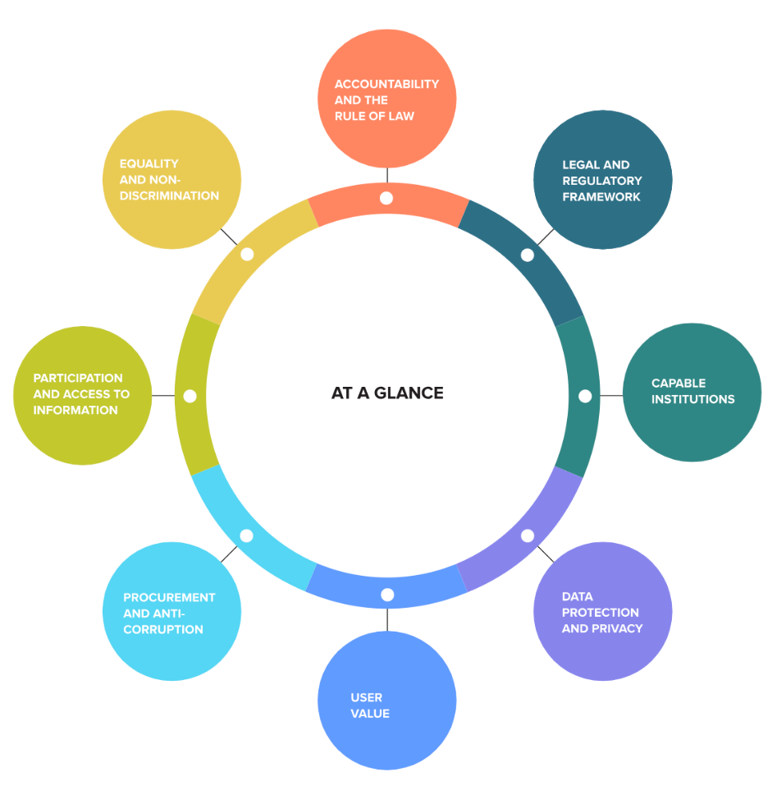
Model Governance Framework of Digital Legal Identity
Outlines:
Illustrative overview
8 detailed categories
Category context
Anchor questions
High-level elements that are crucial for the robust governance system
Helpful description and context to what each category contains
Key questions to pose in reviews, workshops, etc. on each category
Rights implications
Example scenarios
Explanation on how each element impacts on the lives of people from human rights perspectives
Some model example for each element that describes some of the ideal status

Slide 16
Model Governance Framework of Digital Legal Identity
Methodology of Implementations:
Study the Framework
Identify valuable national use cases or purpose of the ID system
Customize the framework to meet your needs (defining elements and anchor questions)
Conduct desk-based research, and interviews with key informants to map the framework against your findings.
Identify gaps in information and/or the need for further research.
Use mapping information to do an analysis identifying strengths and weaknesses.
Convene a meeting of stakeholders to validate analysis, fill gaps in knowledge and generate recommendations for policy.
Use analysis and workshop outcomes to generate an implementation strategy.

Slide 17
Model Governance Framework of Digital Legal Identity
Use Case (Desk Review):
Insufficient information on redressal system: There is a real-time SMS and USSD redressal system but other system that involves non-digital means seem lacking.
Discriminatory Practice against LGBTQI+: Transgender and gender nonconforming people struggled to prove their gender identity to officials
Lack of human-rights centered design: No reports of human rights impact assessments conducted yet.
Insufficient Effort of Inclusion: A lack of training in sign language for registration officials made it difficult for the people with hearing impairment to register, and registration sites were often physically inaccessible.
Insufficient access to information: Country X’s national ID agency and Homeland Security’s websites are inaccessible from outside the country.
Lack of Data Protection Law: In the absence of a data protection law, the Government of X has, in the last five years, embarked on a mass data collection through the national biometric ID.
Gap in Implementation of Anti-Corruption Law: Country X is seen to have strong anti-corruption laws and institutions and initiatives by the private sector complement the governmental efforts. However, experts state that there is still a significant gap between law and practice
Access to education and health for children: As the national ID became available for 16+ years old, it became mandatory to have national ID for the access to education and health, which creates an exclusion concerns.

Slide 18
Call for Pilot Countries in 2024
UNDP is calling for countries who want to implement this model governance framework in 2024!
Approx. 7 weeks project from desk review, mission, and production of reports with recommendations
If you are interested, please contact: risa.arai@undp.org

Slide 19
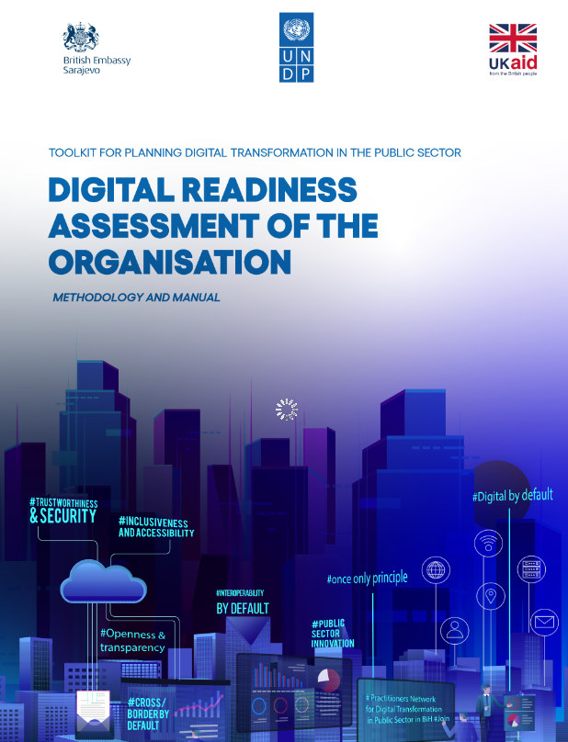
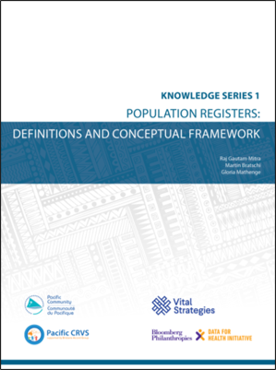
Model Governance Framework of Digital Legal Identity
Other Relevant Resources
https://purl.org/spc/digilib/doc/hb7ub

