Slide 1
Overview of Finalized ACSA Resources
(Design Principles, Data Standards, Functional and Non-
Functional Requirements)
Presenter- Henrietta Brobbey Ameyaw
APAI-CRVS SECRETARIAT
EGMRG 17- 21 July 2026- Victoria Falls Zimbabwe

Slide 2




Why ACSA?
Country after country in Africa faced the same challenge:
Fragmented systems
Vendor lock-in
Every country starts from scratch, procuring expensive proprietary solutions designed for other contexts.
Proprietary platforms trap countries in costly upgrade and maintenance dependency with no exit strategy
Siloed investment
Weak vital statistics
Digital tools built for one ministry or agency cannot talk to another and cannot generate national vital statistics.
Decentralized service delivery without data aggregation produces local records but no national picture.
ACSA's answer: a continental normative standard — not a single software product — that any compliant system must meet.

Slide 3



ACSA and the new CRVS decade
ACSA is the technical fulfilment of three successive accelerator mandates and the digital pillar of the decade theme.
Interoperabilty
Decentralization
Digitalization
ACSA's interoperability standards enable CRVS to connect with health, ID, education, and social protection making civil registration the connective tissue of national DPI.
ACSA's functional requirements define what must stay centralized (the authoritative register) and what can be delivered locally ; certification, notification, and mobile registration.
ACSA is Africa's shared foundation for eCRVS investment ensuring every country's digital transformation is built on the same open, interoperable, country-owned standard.
Ministerial Mandates:
COM4 Nouakchott 2017: Develop common ICT assets for Africa's CRVS
COM5 Lusaka 2019: Strengthen digital investment & interoperability
ACSA 2026: Technical fulfilment — standards finalized

Slide 4




Components of the ACSA Framework
Together they answer: what should an African eCRVS system do, how should it do it, and what values should it embody?
Integration
Decentralization
Digitalization
1
2
3
4
Design Principles
Data Standards
Functional Requirements
Non-Functional Requirements
The values
The language
What the system must do
How well it must do it
Eight foundational values and architecture commitments that every ACSA-compliant system must embody , from country ownership to data sovereignty.
Standardized data fields, definitions, coding structures, and exchange protocols across all vital events - enabling systems to communicate reliably.
Detailed specification of every function an eCRVS must perform across the full vital events lifecycle, from birth notification to cause-of-death coding.
Seven performance standards covering security, availability, scalability, interoperability, accessibility, performance, and maintainability.
3

Slide 5





DESIGN PRINCIPLES
The values every compliant system must embody:
Design Principles are not aspirational guidelines. They are binding architecture commitments
Integration
Decentralization
Digitalization
Country Ownership
Openness
Interoperability
Data Sovereignty
Every ACSA system is governed by the country it serves. No vendor or external party holds authority over the civil register.
Open standards, Countries must be able to build on, adapt, and audit their system.
Compliant systems can exchange data with health, ID, statistics, and social protection systems through published, versioned APIs.
Civil registration data remains within national jurisdiction. No mandatory external cloud storage or offshore data processing.
Sustainability
Inclusivity
Privacy & Security
Modularity
Systems must be maintainable by national ICT teams without perpetual external financing or single-vendor dependency.
Design explicitly accommodates mobile, low-literacy, offline, and multilingual use cases - not retrofitted for them.
Data protection is built into system architecture from the outset, in compliance with national data protection law and continental frameworks.
Systems can be extended incrementally
,adding vital events, digital layers, or integrations without full system re-architecture.
5

Slide 6


DATA STANDARDS
A shared language for civil registration data across Africa- what data is collected, how it is defined, how it is coded, and how it moves between systems
Integration
Digitalization
Minimum Data Sets
Why data standards are the foundation
Standardized mandatory fields for each vital event - birth, death, marriage, divorce - distinguishing notification fields (fewer) from registration fields (complete) and statistical fields.
Without common data standards, civil registration data cannot be aggregated nationally and without national aggregation, vital statistics cannot be produced.
Cause of Death
ICD-10/ICD-11 compliant cause-of-death coding standards, enabling internationally comparable mortality data and contributing to global disease burden analysis.
Data standards are the technical bridge between decentralized service delivery and centralized vital statistics generation. They are what makes CRVS a public health and governance tool, not just a documentary service.
Person Identifiers
Standards for unique person identification across vital events, enabling record linkage across birth, marriage, and death without requiring a national ID number at the point of registration.
For ACSA, data standards also enable a country's eCRVS system to be compared, benchmarked, and audited against a continental reference - so adoption is verifiable and quality is measurable.
Exchange Protocols
Health IT system compliant that interfaces for health-CRVS data exchange; standardized API schemas for ID system integration; batch formats for statistical reporting to NSOs.

Slide 7


FUNCTIONAL REQUIREMENTS
Functional requirements define the complete set of operations an eCRVS system must perform across all vital events and all roles.
Integration
Decentralization
Digitalization
Birth
Death
Marriage
Divorce
Birth notification
Death notification
Marriage registration
Dissolution registration
Birth registration
Death registration & cause-of-death coding
Certificate issuance
Court order integration
Certificate issuance
Burial permit
Customary union recognition
Certificate of dissolution
Cross-cutting functional requirements (all vital events):
User and role management · Audit trail and logging · Search and verification · Offline data entry and sync · Bulk data import and migration · Statistical reporting and export · System administration and configuration · Multi-language support

Slide 8
NON-FUNCTIONAL REQUIREMENTS
How well must the system perform; define the quality attributes of the system, including its usability, security, reliability and performance under different conditions
Integration
Decentralization
Digitalization
Performance
Security
Usability and Accessibility
Reliability and Availability
Safety
Compliance and Legal
Quality

Slide 9


Fitness requirements
Every NFR matters. But three have a disproportionate impact on whether a system actually works in African contexts.
Integration
NFR 4
Decentralization
Digitalization
NFR 7
Availability & Reliability (Offline)
Interoperability
Quality (Maintainability & Auditability)
Why it matters
Why it matters
Why it matters
In much of Africa, internet connectivity is intermittent and power is unreliable. A CRVS system that only works online is not fit for purpose on this continent.
CRVS systems that cannot connect to health, national ID, and statistics systems produce documents, not data. Interoperability is what converts civil registration into governance intelligence.
The most persistent failure in African CRVS digitalization is vendor lock-in: systems that require external support for every upgrade, integration, or correction.
What it requires
What it requires
What it requires
System must support offline registration data capture with reliable synchronisation on reconnection.
Open API architecture; FHIR-compliant health interfaces for notification; standards-based national ID integration; batch export to NSO in defined format.
Open-source codebase or escrow; national team documentation sufficient for independent operation; system health dashboards; data quality reporting and error correction workflow.
Offline capability is not a nice-to-have. It is a baseline requirement for last-mile delivery.
Ghana's Act 1027 and DHIMS-2 integration, and Namibia's electronic death notification, both demonstrate that legal mandate for notification must precede technical integration.
Rwanda's experience shows sustained registration improvement follows from national teams owning their system. Countries dependent on single vendors experience collapse when funding cycles end.

Slide 10
Being ACSA Compliant
ACSA compliance is a verifiable technical and governance status ; not a certificate, not a brand, not a vendor relationship.
✓ ACSA compliance DOES mean
✗ ACSA compliance does NOT mean
Integration
Decentralization
Digitalization
The system implements the eight Design Principles as architecture commitments
Using any specific software product or platform
All mandatory data fields for each vital event conform to ACSA data standards
Procuring from any particular vendor - compliant systems can be nationally built, open-source, or commercial
The system performs all required functional operations across notification, registration, certification, and statistical transfer
Sharing data with any continental or external repository without the country's consent
All seven non-functional performance thresholds are met and verifiable
Replacing a functioning national system - existing systems can be assessed and adapted for compliance
The system can be maintained and operated by national ICT teams independently
A one-time process ; compliance is maintained through ongoing governance and technology management
Data flows to the national register and from there to the NSO for vital statistics production
Full adoption in one step; countries may apply the framework in full, or prioritize the components most relevant to their context

Slide 11
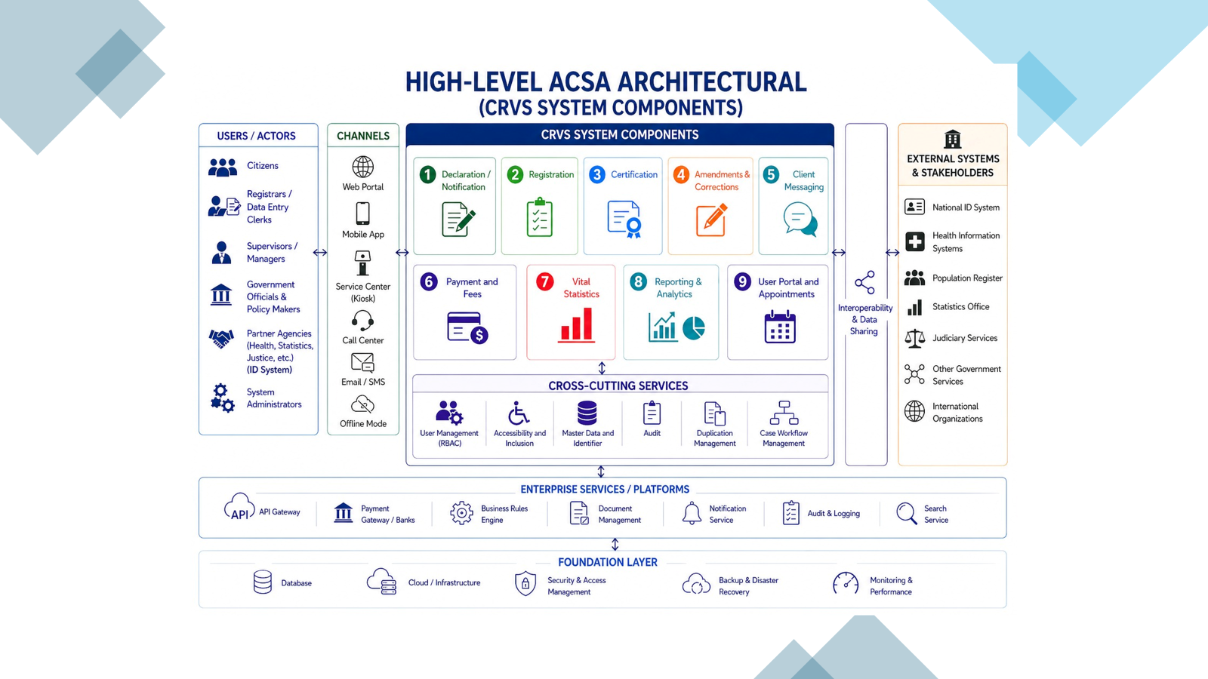


Core architecture
Functional requirements translate the decentralization principle into concrete system design — each function has a defined scope and governance requirement.
Integration
Decentralization
Digitalization
NOTIFICATION
REGISTRATION
CERTIFICATION
Delegate maximally
State authority, local delivery
Digitally decentralized
System must support notification by health workers, community agents, facility staff, and traditional authorities through mobile, offline, and facility-based workflows without those notifications constituting the legal registration.
System must anchor registration to a state-managed registrar with legal authority, while enabling mobile and facility-based registration points to extend coverage. Correction and late registration pathways must be defined and accessible.
Once the national register is digital and verified, certificate issuance must be possible at any connected point , district office, facility, or mobile unit without fragmenting the authoritative central record.
Health workers · Facility staff · Community leaders
Registrar (state authority) · Facility-based agents
Any connected point · Mobile issuance · District office

Slide 12
Conclusion
At a glance, the ACSA framework comprise four components:
Design Principles
Eight binding architecture values - country ownership, openness, interoperability, data sovereignty, sustainability, inclusivity, privacy, and modularity.
Integration
Digitalization
What?
Data Standards
Standardized data fields, cause-of-death coding (ICD-11), person identifiers, and FHIR-compliant exchange protocols for every vital event.
What language?
Functional Requirements
The complete set of operations for birth, death, marriage, and divorce - from community notification through registration, certification, and statistical transfer to NSO. 18 Functional Requirements
What must it do?
Non-Functional Requirements
Seven performance thresholds ; security, performance, reliability& availability (including offline), safety, compliance and legal, usability & accessibility, and quality, all verifiable.
How well?
13

Slide 13

The ASCA Governing Board, Partners and the Secretariat look forward to collaborating with you, welcome your interest and contribution in building a robust and sustainable CRVS Digital Framework for AFRICA

Slide 14
THANK YOU!
Presenter/ Email

