Slide 1



UPDATE MARRIAGE ADMINISTRATION AND REGISTRATION IN MALAWI
THE NATIONAL REGISTRATION BUREAU

Slide 2
LAYOUT
PRESENTATION OUTLINE
Part 1: Introduction
Part 2: What We Have Done
Part 3: Progress Achieved
Part 4: Lessons & Best Practices
Part 5: Challenges
Part 6: Way Forward
Malawi National Registration Bureau | Regional Meeting on Marriage Registration, Zimbabwe

Slide 3
INTRODUCTION
BACKGROUND
Following the transfer of the marriage administration and registration mandate to the National Registration Bureau (NRB) in August 2025, Malawi embarked on a comprehensive reform programme to strengthen the legal, institutional and operational framework governing marriage administration and registration.
This presentation highlights:
  The marriage registration system inherited by the Bureau
  The reforms implemented since assuming the mandate
  The progress achieved to date
  The remaining priorities, and
  Lessons and Best practice
Malawi National Registration Bureau | Regional Meeting on Marriage Registration, Zimbabwe

Slide 4
INTRODUCTION
MARRIAGE ADMINISTRATION AT THE TIME OF HANDOVER
At the time of handover, Malawi had an established legal and institutional framework for marriage administration. However, implementation remained largely decentralized and paper-based, making service delivery inconsistent and inefficient.
Legal Mandate
Marriage ‘Officiants’
Types of Marriages
Registration System
Regulate the celebration and registration of marriages and issue standardized registers, forms and Marriage Certificates.
District Commissioners
Recognized Traditional Authorities
Clerics from authorized religious institutions.
Civil
Customary
Religious
Marriage by Repute/Cohabitation
Paper-based registration under the then-current MDFRA, with marriage records maintained in separate manual paper-based registers across district councils and religious venues (i.e., churches, mosques etc.)
The legal framework was comprehensive, but implementation processes required modernization, standardization and stronger institutional coordination.
Malawi National Registration Bureau | Regional Meeting on Marriage Registration, Zimbabwe

Slide 5
INTRODUCTION
WHAT WE INHERITED
The Bureau inherited a legally established marriage administration system that faced several operational, legislative and technological challenges requiring immediate attention.
Unregulated Marriages and its Certificates
"Ntchatho" certificates were in circulation despite having no legal recognition as proof of marriage.
Fragmented Procedures
Marriage administration and registration practices varied across districts and marriage ‘registrars’ including –
  District Commissioners (Civil Marriages)
  Clerics (Religious Marriages)
  Traditional Authorities (Customary Marriages)
Weak Record Verification
Marriage records were maintained without systematic verification against the National Identification Database affecting data quality and limiting efficient verification of marital status and proof of age.
Overlapping Legislative Framework
The National Registration Act (NRA) and the Marriage, Divorce and Family Relations Act (MDFRA) contained overlapping provisions and institutional mandates.
Manual Registration System
Marriage administration relied almost entirely on manual, paper-based processes, limiting efficiency, consistency and data management.
Missing records of divorce
Records of divorce were not systematically recorded or maintained
These issues formed the baseline for reform.
Malawi National Registration Bureau | Regional Meeting on Marriage Registration, Zimbabwe

Slide 6
INTRODUCTION
Reform Priorities
To address these challenges, the Bureau prioritised reforms aimed at strengthening governance, improving service delivery and laying the foundation for a digitalised marriage registration system.
Legal Reform
Institutional Strengthening
Digital Transformation
Review and harmonise the National Registration Act (NRA) and the Marriage, Divorce and Family Relations Act (MDFRA) to establish a coherent legislative framework.
Standardise operational procedures, strengthen institutional coordination and build the capacity of marriage registrars nationwide.
Develop and deploy an integrated digital marriage registration system linked to the National Identification Database.
Together, these reforms areas provide the foundation for Malawi's transition to a modern, integrated and citizen-centred marriage registration system.
Malawi National Registration Bureau | Regional Meeting on Marriage Registration, Zimbabwe

Slide 7


WHAT WE HAVE DONE
Legal Reform
The joint review of the National Registration Act (NRA) and the Marriage, Divorce and Family Relations Act (MDFRA) is the Bureau's flagship reform initiative.
Current Status
Why the Review is Necessary
Strengthen the legal framework
Modernise Registration Processes: Transition from manual registers to a centrally managed digital registration system.
Strengthen Proof of Age: Require the National ID as the primary proof of age during marriage registration.
Establish a Single Evidentiary Standard: Recognise NRB-issued Marriage Certificates as the definitive legal evidence of marriage.
Harmonise Legislation: Remove overlapping provisions between the NRA and MDFRA.
Inception meeting completed
Review methodology agreed
Stakeholder consultations underway
Draft amendments under preparation for legislative submission
Malawi National Registration Bureau | Regional Meeting on Marriage Registration, Zimbabwe

Slide 8




WHAT WE HAVE DONE
WHY THIS MATTERS
The reforms will create a marriage registration system that is
Legally grounded
Nationally Consistent
Digitalised
Client -centred
Future-ready
Reduces public misunderstanding and legal disputes over marriage status.
One registration pathway regardless of district, religion, or officiant type.
More precise, secure and available marriage data for planning and social protection.
Well-defined roles and digital systems reduce delays for citizens.
Keeps the legal framework functional in a digital governance landscape.
Malawi National Registration Bureau | Regional Meeting on Marriage Registration, Zimbabwe

Slide 9
WHAT WE HAVE DONE
INSTITUTIONAL STRENGTHENING
Alongside legal reform, the Bureau has invested in strengthening the operational systems required for consistent nationwide implementation including -
Business Processes
Operational Tools
Stakeholder Engagement
Orientation & Training
The end-to-end marriage registration workflow was mapped and standard operating procedures revised accordingly.
Software developed and rolledout
Training manuals and desk instructions finalised and distributed.
Continuous consultations with Government institutions, development partners and stakeholders.
All Civil marriage “registrars” trained on civil marriages administration and registration
Religious “registrars” pending refresher orientation to strengthen compliance
Customary “registrars” yet to be trained (customary marriages not yet rolled out)
Malawi National Registration Bureau | Regional Meeting on Marriage Registration, Zimbabwe

Slide 10
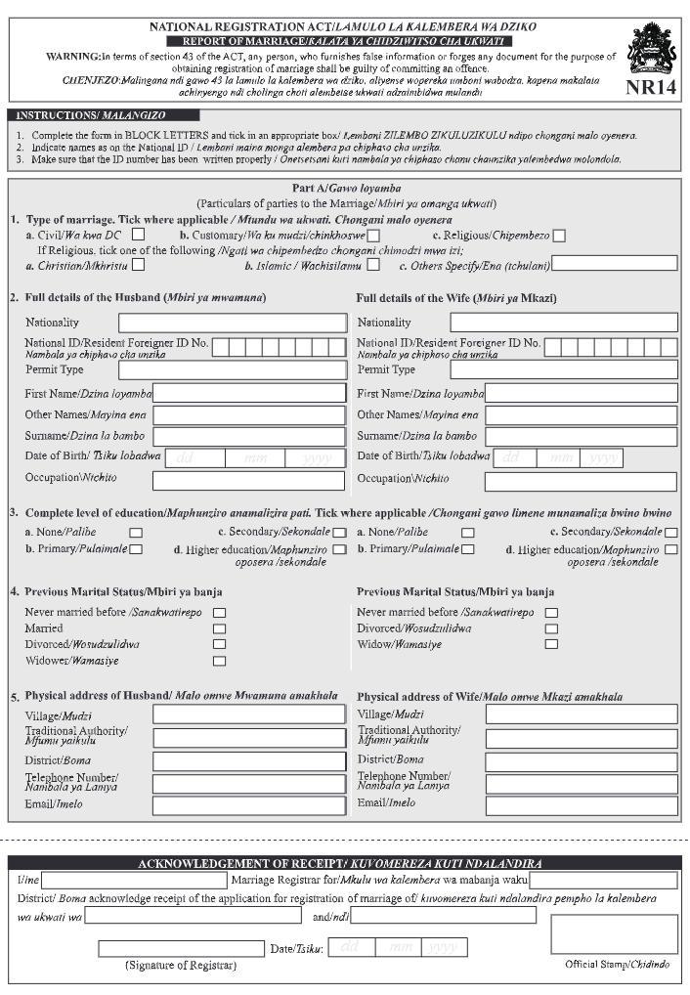




WHAT WE HAVE DONE
DIGITAL TRANSFORMATION
Marriage registration now follows a structured workflow designed to improve efficiency, strengthen identity verification and support national record management.
NR14 Form
National ID Check
Central Database
Certificate Issued
Completed by the marriage couple/ officiant at the point of registration
Both parties verified against the National Identification Database
→
→
Record captured in NRB's marriage registration software
→
Legally valid Marriage Certificate printed from system
Marriage registration software, database and reporting tools developed in-house and ready for rollout
System piloted with NRB staff and District Commissioners, with dedicated orientation
Registration linked to the National Identification Database to enhance data accuracy
Malawi National Registration Bureau | Regional Meeting on Marriage Registration, Zimbabwe

Slide 11
PROGRESS ACHIEVED
TIMELINE & MILESTONES
Aug 2025
Official Handover
Marriage administration and registration mandate transferred to the NRB.
Marriage records transferred
Oct 2025 – July 2026
Capacity building for Civil Registrars completed
Capacity building of NRB staff on Marriage software ongoing
Awareness campaigns on mandate transfer and marriage types, protocols, systems etc.
Second legal reform underway
Ntchatho certificate issuance suspended
Development of standard operating procedures for licensing places of worship & officiants
Oct 2025
Nairobi Symposium
Malawi presents baseline system and reform priorities
Malawi National Registration Bureau | Regional Meeting on Marriage Registration, Zimbabwe
3

Slide 12



NEXT PHASE OF REFORM
Planned Activities
Significant progress has been made in establishing the foundations for reform. The next phase focuses on nationwide implementation, legislative completion and full operationalisation.
Nationwide Orientation
Licensing Places of Worship
Full Software Deployment
Enactment of Amendments
Orientation sessions for religious institutions, mother bodies, clergy currently partial, not yet nationwide.
Roll out of Customary marriages and training traditional authorities
Licensing of places of worship authorised to celebrate marriages has not yet commenced.
Marriage registration software is deployed.
The Proposed NRA/MDFRA review is still ongoing and not yet finalized
Malawi National Registration Bureau | Regional Meeting on Marriage Registration, Zimbabwe

Slide 13
LESSONS LEARNED & BEST PRACTICES
Lessons Learned and Best Practices
Early Stakeholder Engagement
Standardized Procedures
Identity Verification
Pilot Before Scale
Continuous, direct engagement with the authorities who officiate marriages builds legitimacy and buy-in for reform.
A single, detailed step-by-step guide for marriage officiants reduces inconsistency across Malawi's 28 districts and many types of registrar.
Making the National ID and birth certificate mandatory at the point of registration strengthens data integrity from day one, rather than trying to fix records after the fact.
Testing the registration software and processes with a subset of staff and districts before wider rollout reduces implementation risk.
Malawi National Registration Bureau | Regional Meeting on Marriage Registration, Zimbabwe

Slide 14
CHALLENGES
Implementing nationwide reform has highlighted several practical challenges that continue to shape implementation.
Legislative Timelines
Amending national legislation requires Cabinet, technical and Parliamentary processes that extend the pace of reform beyond the Bureau's direct control.
Nationwide Coordination
Coordinating a wide, decentralised network of officiants, incl. District Commissioners, clergy and traditional leaders, across every district is resource-intensive.
Shifting Established Practice
Moving communities and institutions away from long-standing informal practices, such as unregulated certificates, takes sustained engagement.
Technology & Infrastructure
Extending software, connectivity and equipment from pilot sites to full national coverage requires significant investment.
Malawi National Registration Bureau | Regional Meeting on Marriage Registration, Zimbabwe

Slide 15
NEXT STEPS
WAY FORWARD
1
2
3
4
5
Deploy the marriage registration software beyond district registration offices.
Finalize the NRA/MDFRA amendment package and complete stakeholder validation ahead of formal legislative submission.
Use NRB Identity documents for Identity, marital status & age verification
Commence licensing of places of worship authorised to celebrate Marriages.
Roll out nationwide orientation for Religious and Traditional authorities
Digitization of historical Marriage records
Develop system and workflow for Divorce registration
The Bureau will continue implementing these reforms through a phased approach that balances legislative reform, institutional readiness and nationwide deployment to achieve a modern, integrated and sustainable marriage registration system.
Malawi National Registration Bureau | Regional Meeting on Marriage Registration, Zimbabwe

Slide 16

Malawi National Registration Bureau | Regional Meeting on Marriage Registration, Zimbabwe
THANK YOU
Questions and Discussion
17

