Slide 1
"The New CRVS Decade (2026–2036) —
A Bold Vision for Consolidation and Action"
William Muhwava
African Centre for Statistics
EGMRG 17- 21 July 2026- Victoria Falls Zimbabwe

Slide 2
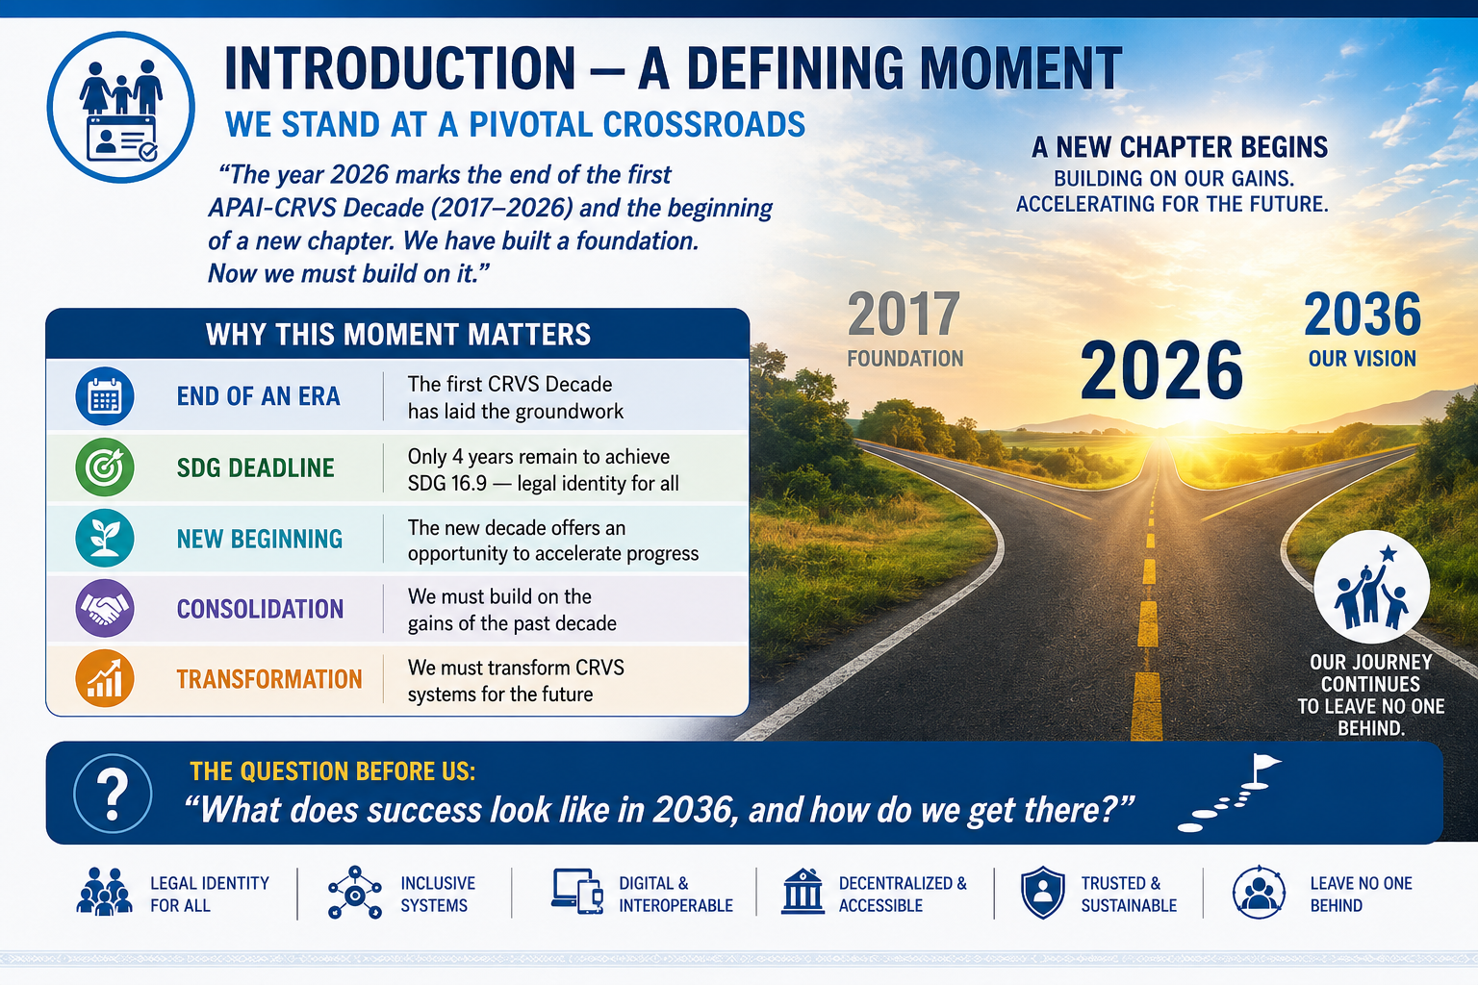

Slide 3
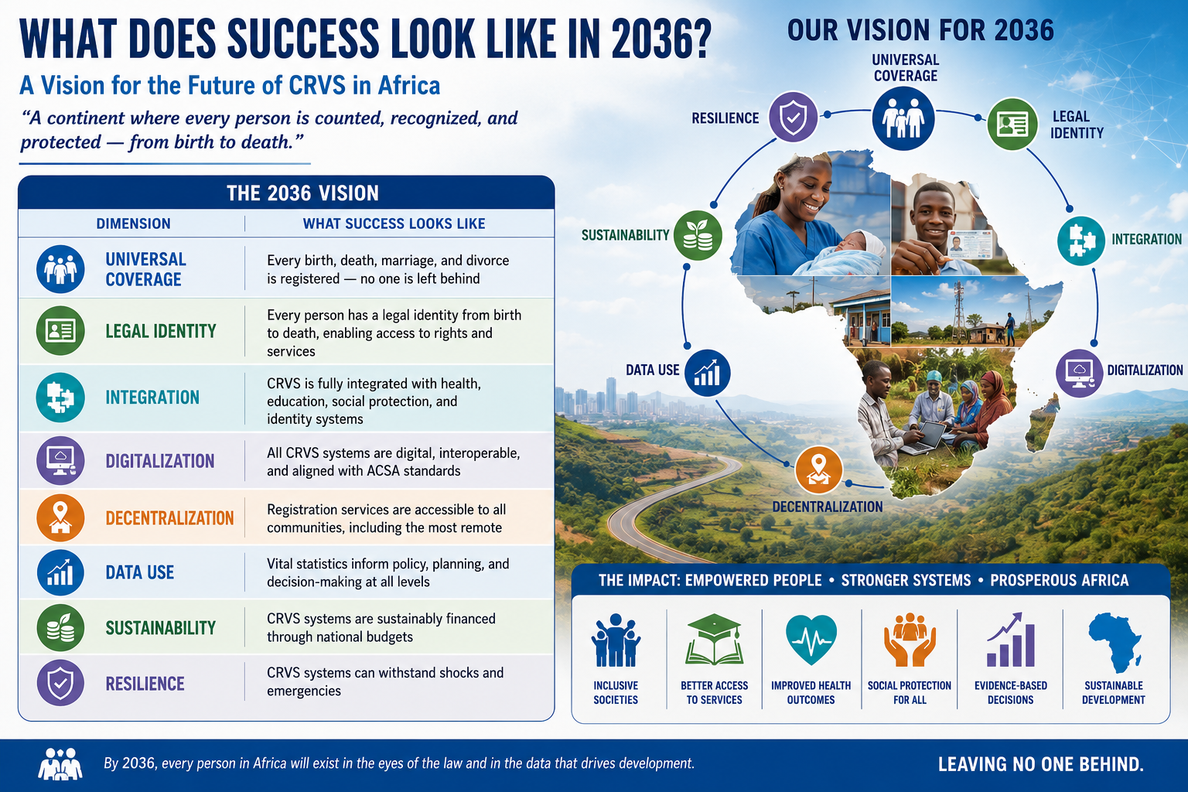

Slide 4
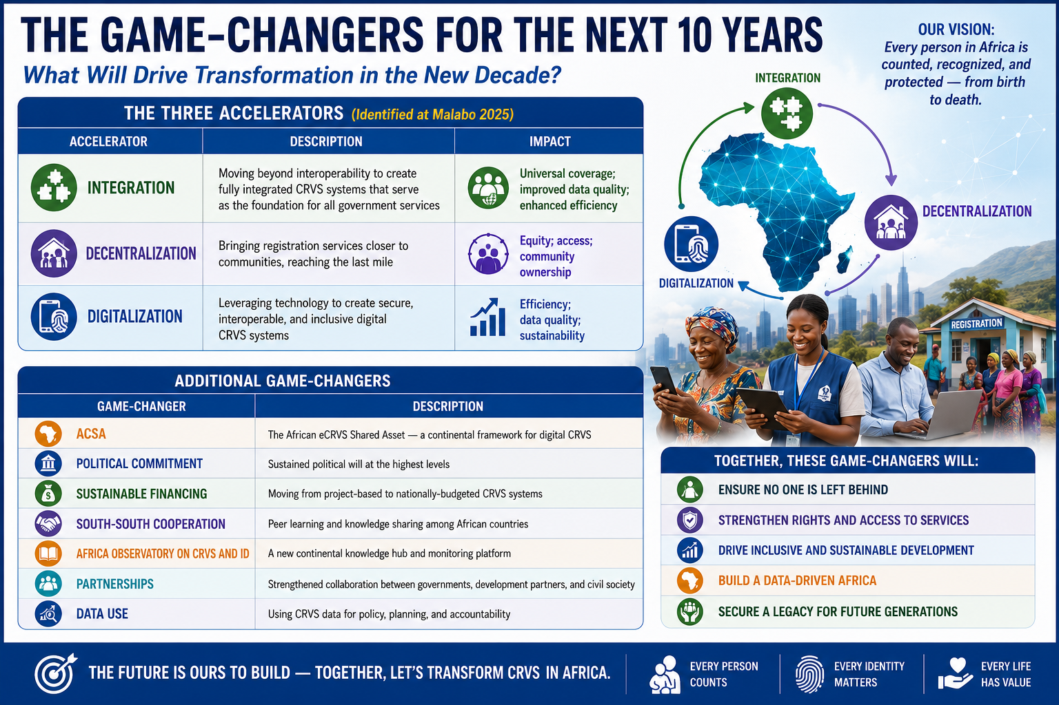

Slide 5
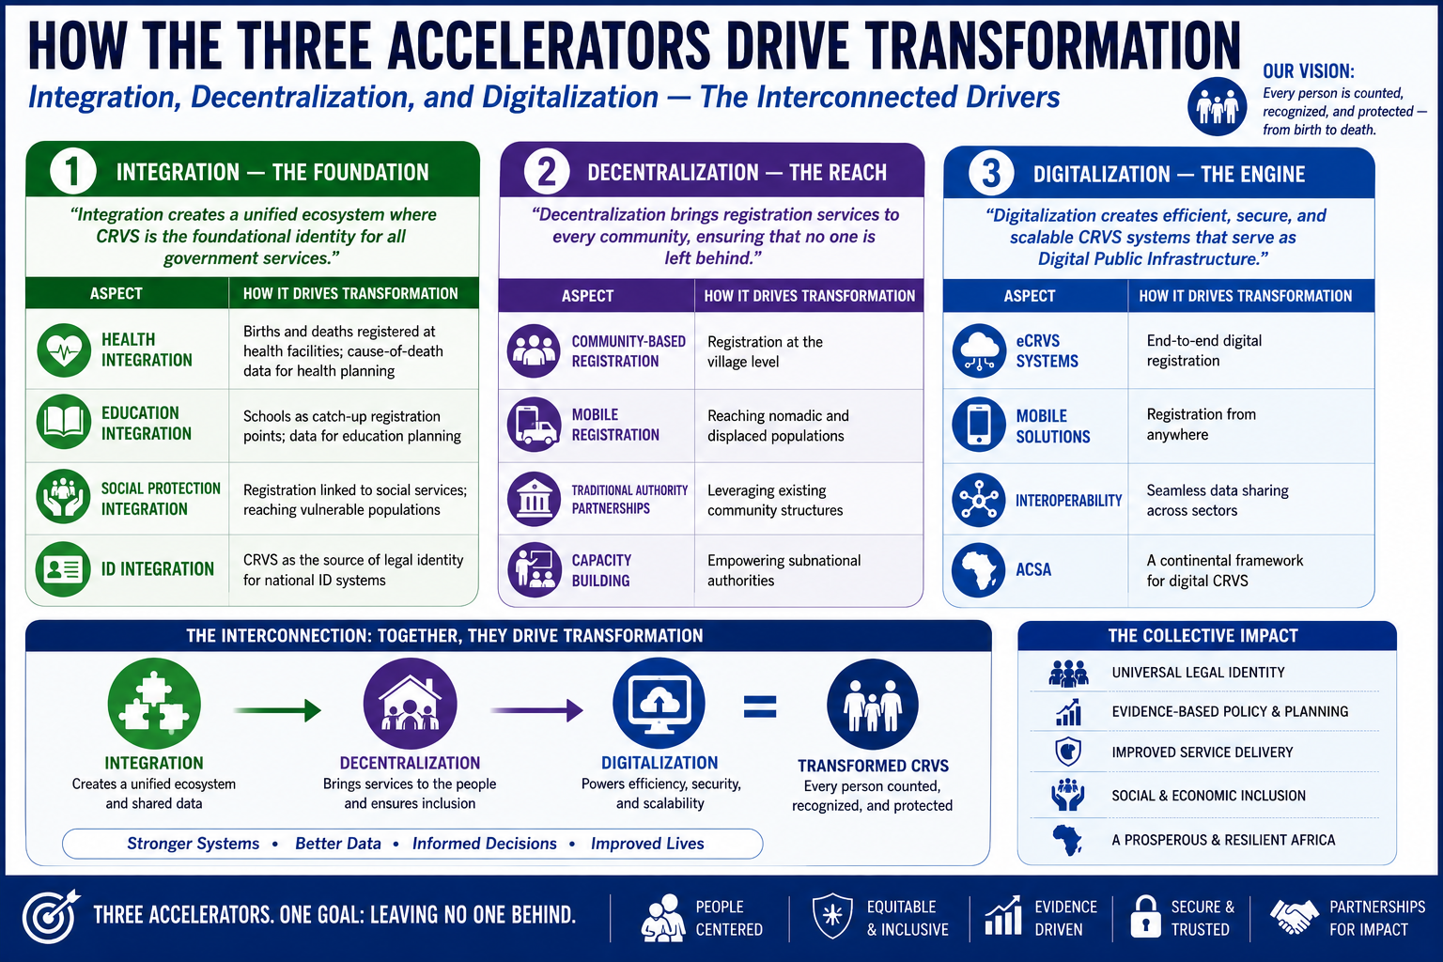

Slide 6
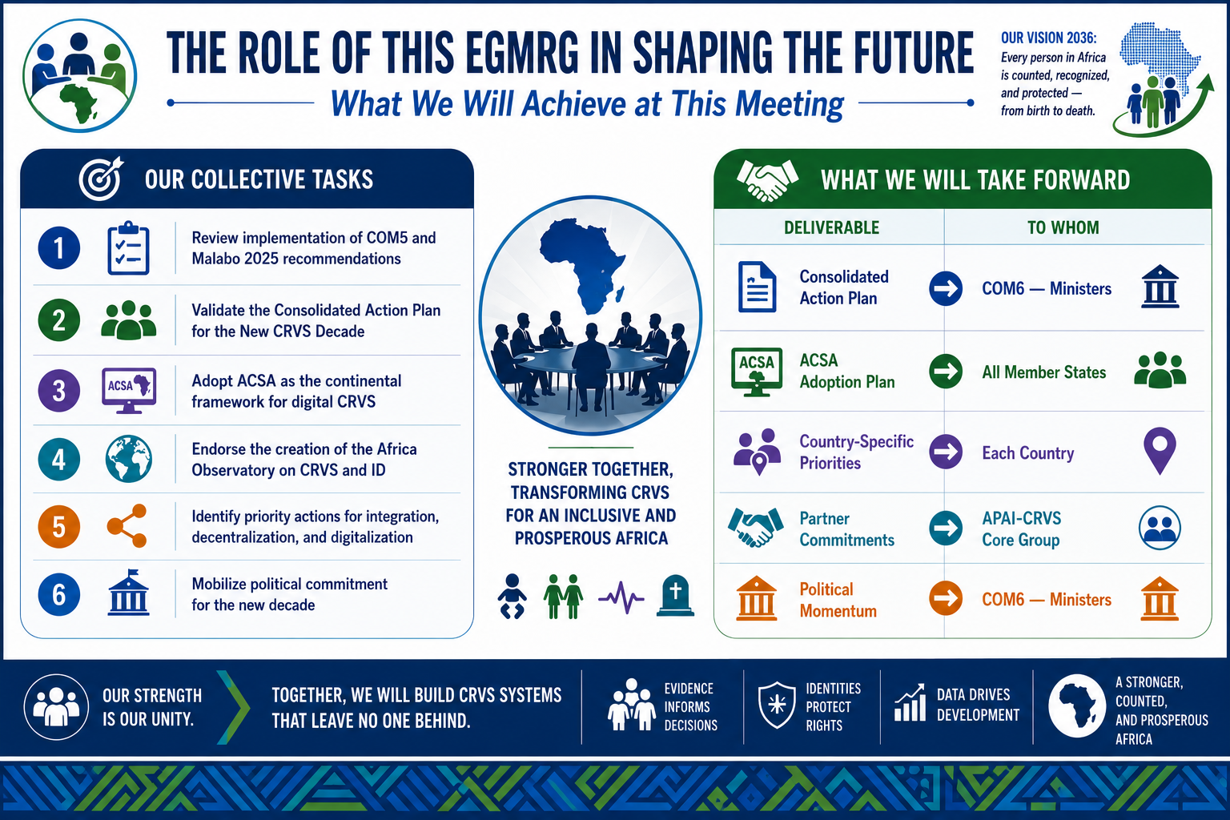

Slide 7
Thank You!
William Muhwava

