Slide 1





Next Steps - Marriage and Divorce Registration Guidelines
UNFPA, UNECA & UNICEF
Presented by: Violet Kinuthia,
Centre of Excellence for CRVS Systems

Slide 2
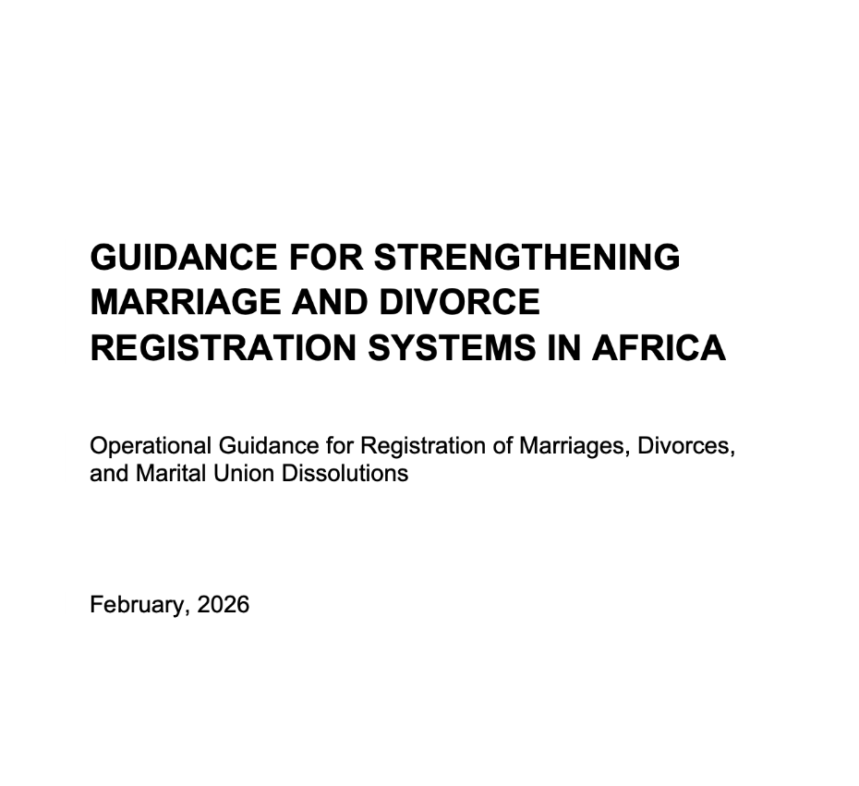

Current version: English to be circulated today
French, Arabic and Portuguese versions are undergoing translation to be circulated to Francophone, Arab States and Lusophone countries by next week on Friday 31 July

Slide 3

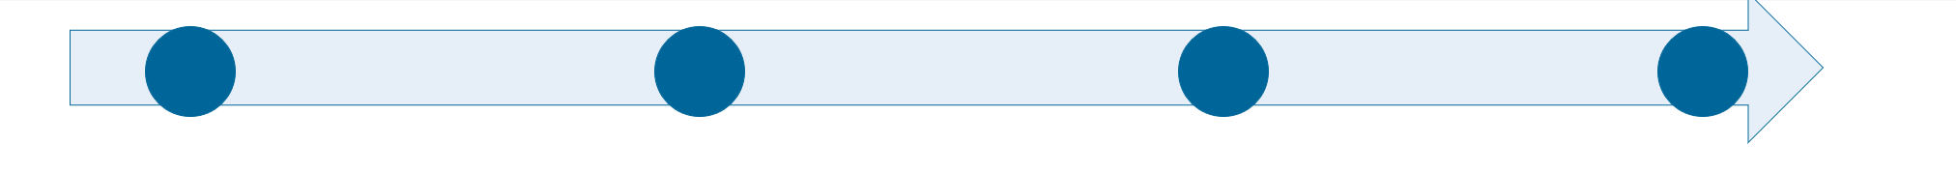
Process for Adoption of Marriage and Divorce Registration Operational Guidelines for Africa
COM6 and LAS - Launch of Marriage + Divorce Registration Guideline
July 31
August 31
Sept 30
October
Translated versions circulated to all Member States for review and clearance
3 Webinars for final validation
Webinar 1 - English + Portuguese
Webinar 2 - French
Webinar 3 - Arabic
FINAL EDITORIAL, DESIGN
GUIDANCE FOR STRENGTHENING MARRIAGE AND DIVORCE REGISTRATION SYSTEMS IN AFRICA
Operational Guidance for Registration of Marriages, Divorces, and Marital Union Dissolutions
Adoption and Launch at the Ministerial Conferences

Slide 4









Thank You

